Slide 1
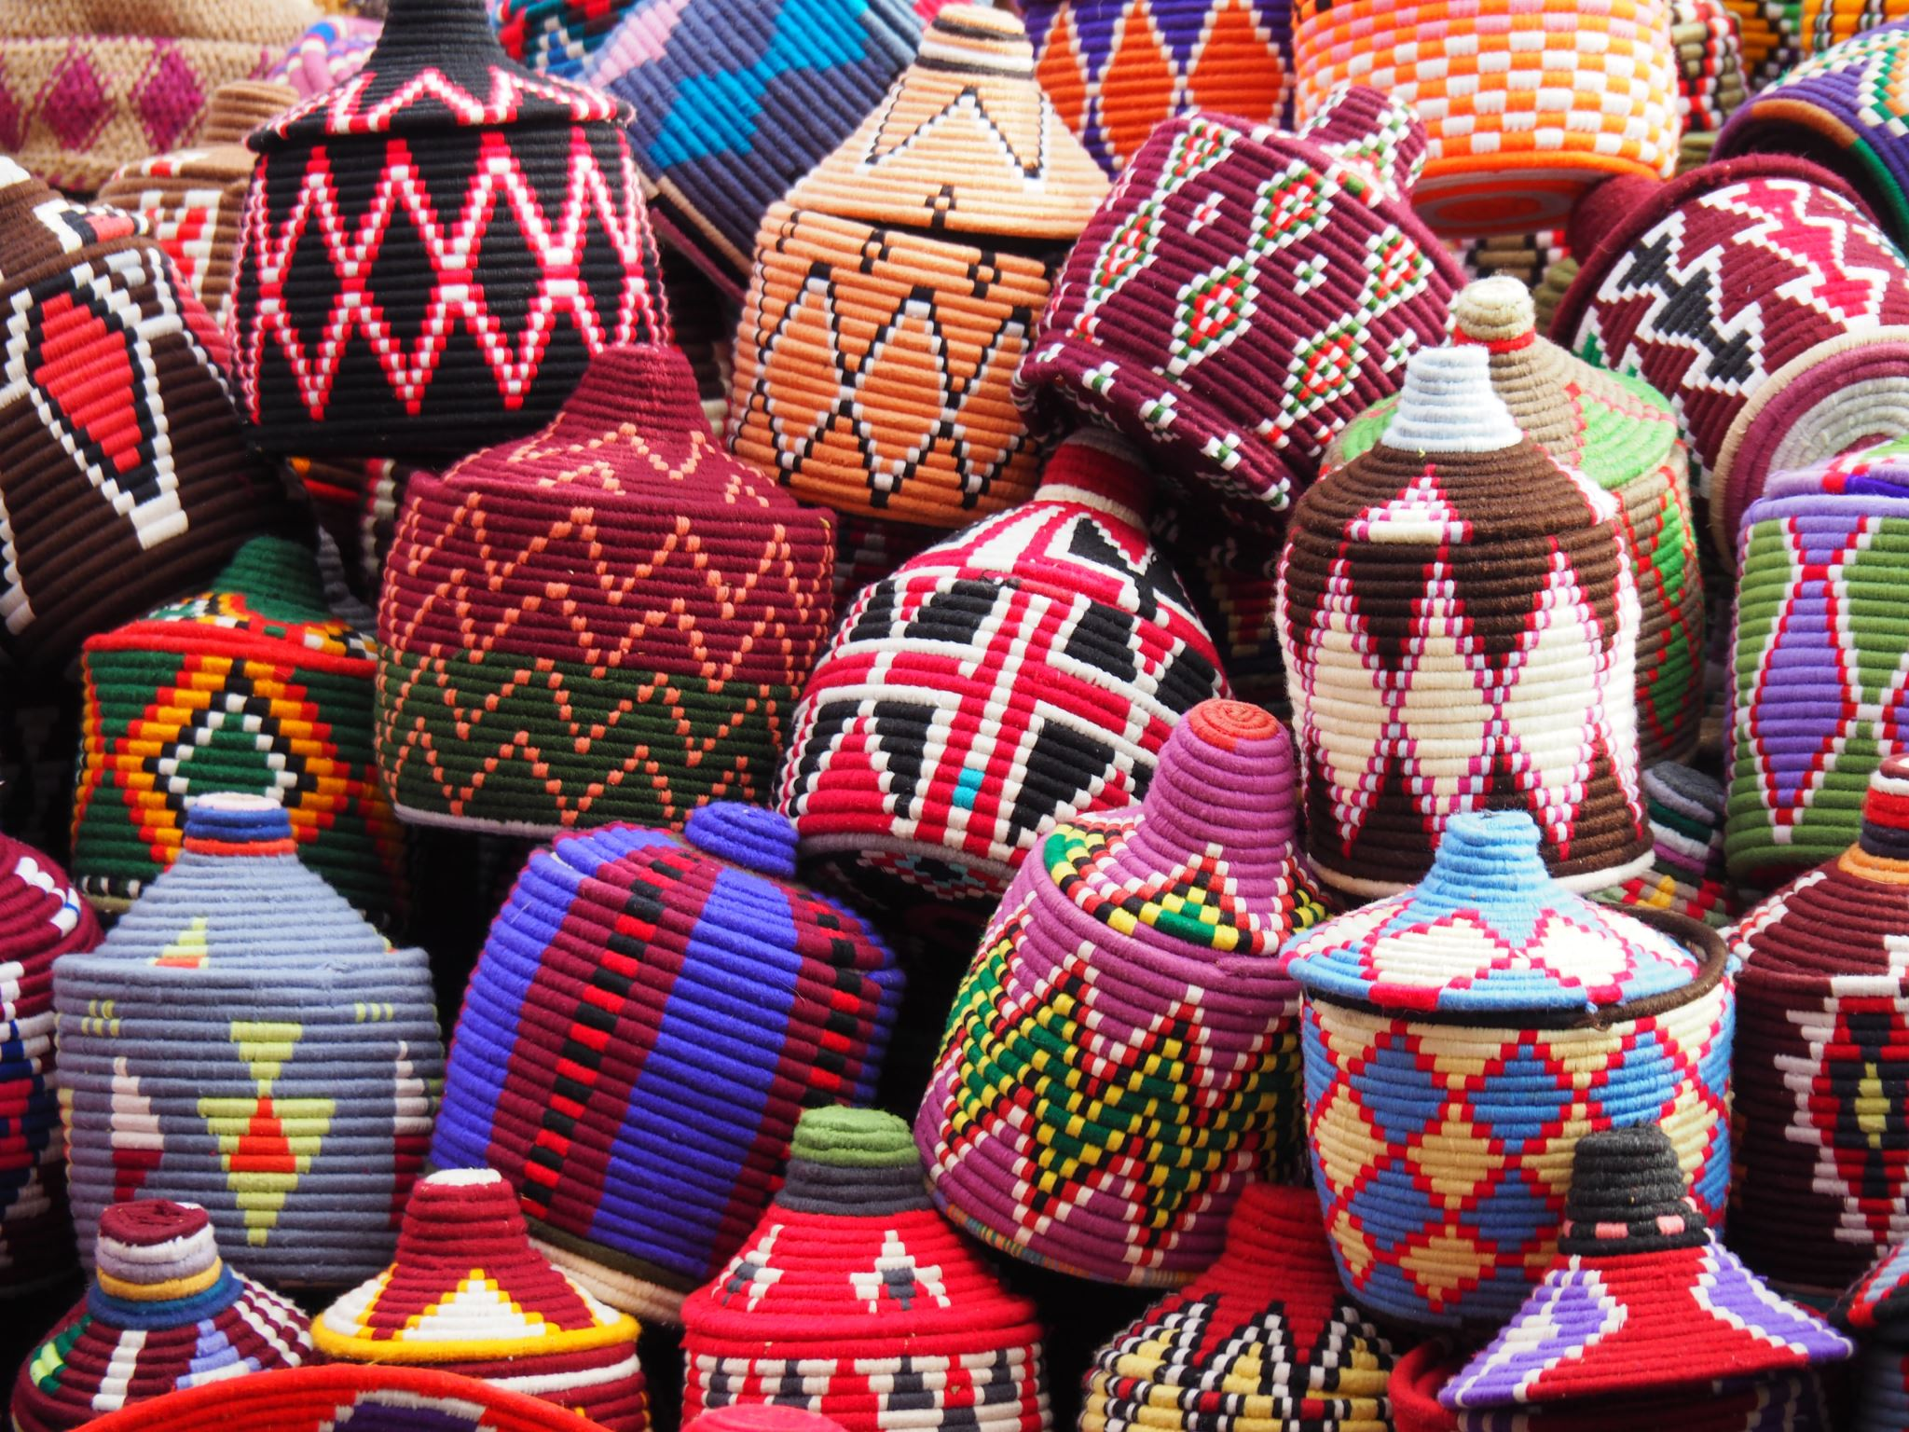
Beautiful Baskets
Some more beautiful than others……

Slide 2
Types of Baskets
Coiled – uses grasses, rushes, pine needles, etc
Plaited – wide and braidlike materials like palms, yucca, New Zealand flax
Twined - Uses materials like roots and tree bark
Wicker/splint – uses reed, cane, willow, oak or ash

Slide 3
Coiled Baskets
created by arranging or winding something long and flexible in a joined sequence of concentric circles or rings

Slide 4
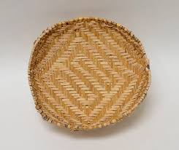
Plaited Baskets
created by joining three or more pieces of string-like material by putting them over each other in a special pattern

Slide 5
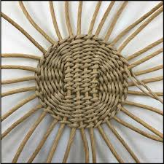
Twined Baskets
created when the threads are twisted in twos or threes and twined around the standards or enclosing them

Slide 6
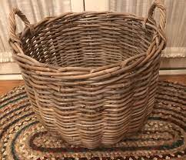
Wicker or Splint Baskets
generally large and carried by a beast of burden or on a person

Slide 7
Basket Making / Weaving
Very widespread craft in human history
Difficult to say how long it has been done
Materials can decay
Much has been lost over time
Notes:
While the oldest known basket is estimated to be approximately 12,000 years old, it is speculated that basketry has been practiced for much longer than that. Unfortunately, the natural fibers used to make baskets are difficult to preserve, which makes it hard to define exactly how old the craft is - if not impossible. Although Native American cultures are most predominantly referenced when the topic of basket weaving is discussed, the art of basketry has been practiced in many other cultures around the world, as well. For example, baskets have played an integral role in both China and Japan, where they are used for both aesthetic and utilitarian purposes, like fishing, funeral basketry, and food storage.

Slide 8
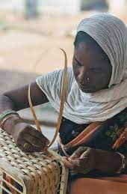
Worldwide Basket Making
India

Slide 9
Chinese, Japanese and Taiwanese

Slide 10
Australian Eel Baskets

Slide 11
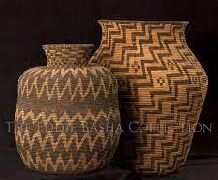
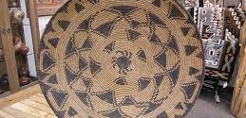
Apache Baskets

Slide 12
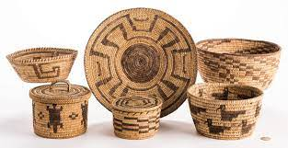
Popago Baskets

Slide 13
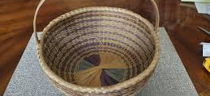
Black Ash Baskets

Slide 14
Convenient and Public

Slide 15
Our Prized Apache Basket

Slide 16
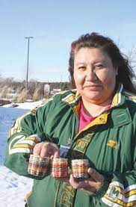
Kimberly Crowley Baskets
Member of the Ho-Chunk tribe
Very well known Wisconsin indigenous artist
Selling her baskets in Mount Horub on May 18th

Slide 17
Baskets in our Basement
I have many that can be used to surround pots with plants in them stored near the plant station and light gardens in our basement.

Slide 18
Balancing Act
To add beauty and a little tension to the bedroom

Slide 19
Nice humid display area
The laundry room is a good place to display currently unused baskets

Slide 20
Office Storage
Magazines, unread books, brochures, etc.

Slide 21
Recycling
Newspapers, boxes, etc. until next recycling pickup

Slide 22
Gardening
Collecting and bringing in garden veggies or carrying stuff out to the compost

Slide 23
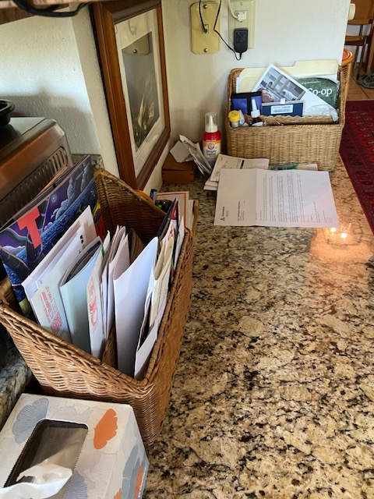
Throughout the House….

Slide 24
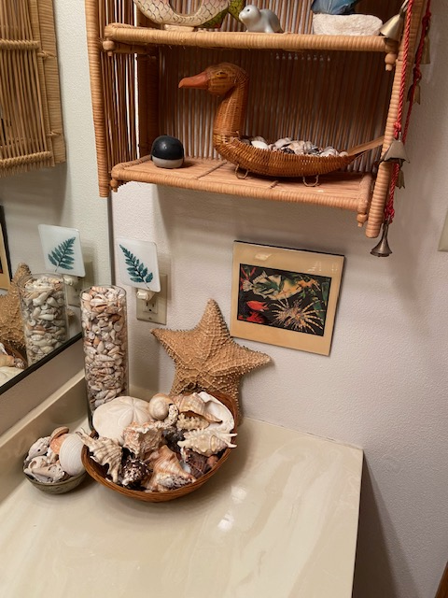
More …

