Slide 1
No Need for Return on Investment
A tale of adventure, investigation, education, and
friendship

Slide 2
ROI
ROI, or Return on Investment, is defined as a financial metric that measures the profitability of an investment relative to its cost.
It is calculated by dividing the net profit from an investment by the cost of the investment and is expressed as a percentage

Slide 3
How Did This Project Start?
1986 - Car paint and storage
2021 - The big question
2021 – The big answer
2021 (August) – The beginning of the journey

Slide 4
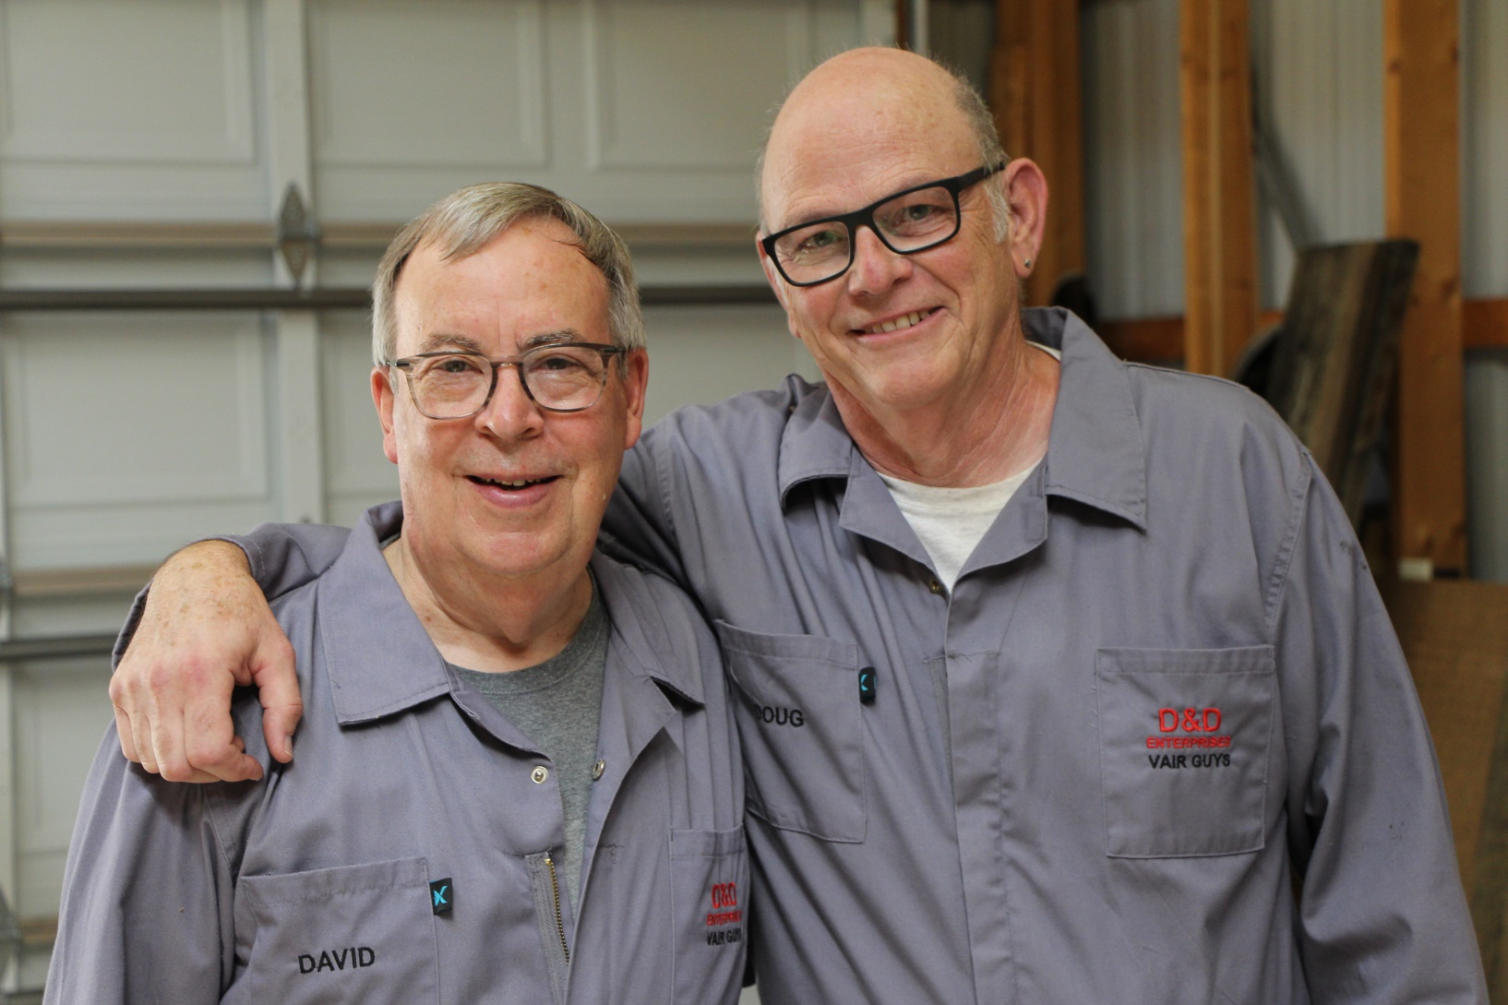
THE VAIR GUYS

Slide 5
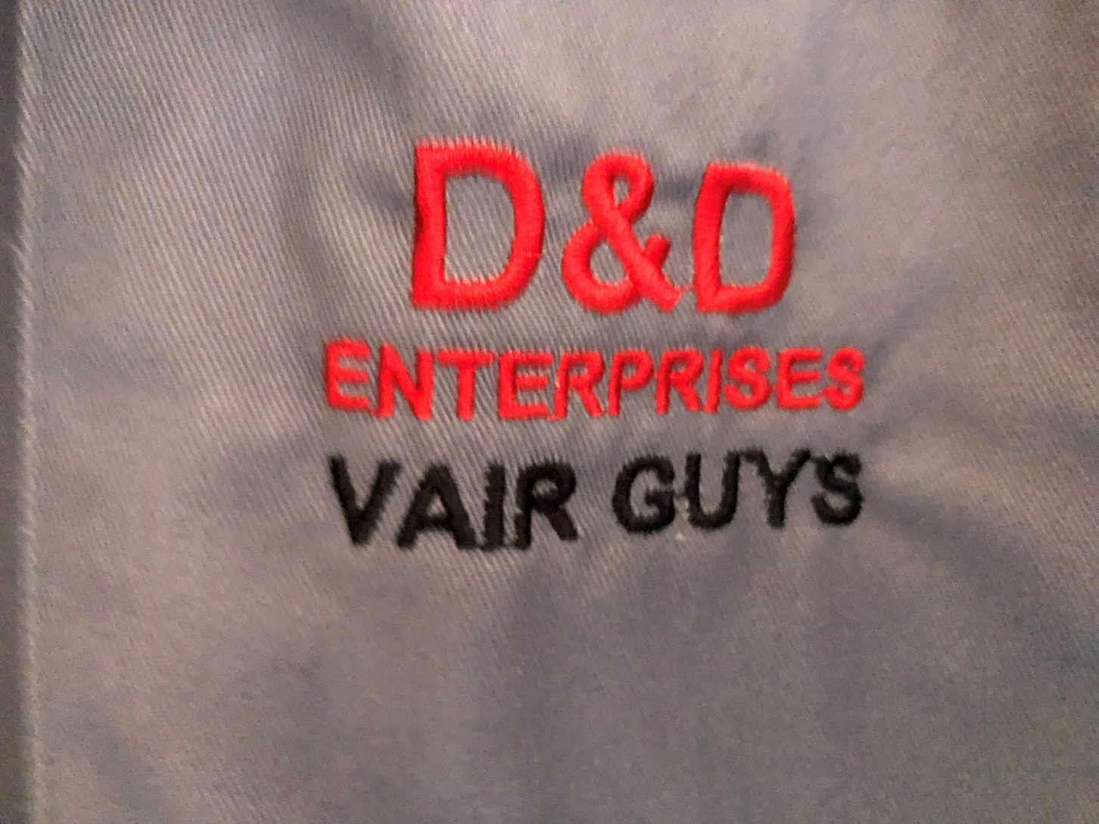
Vair Guys logo

Slide 6
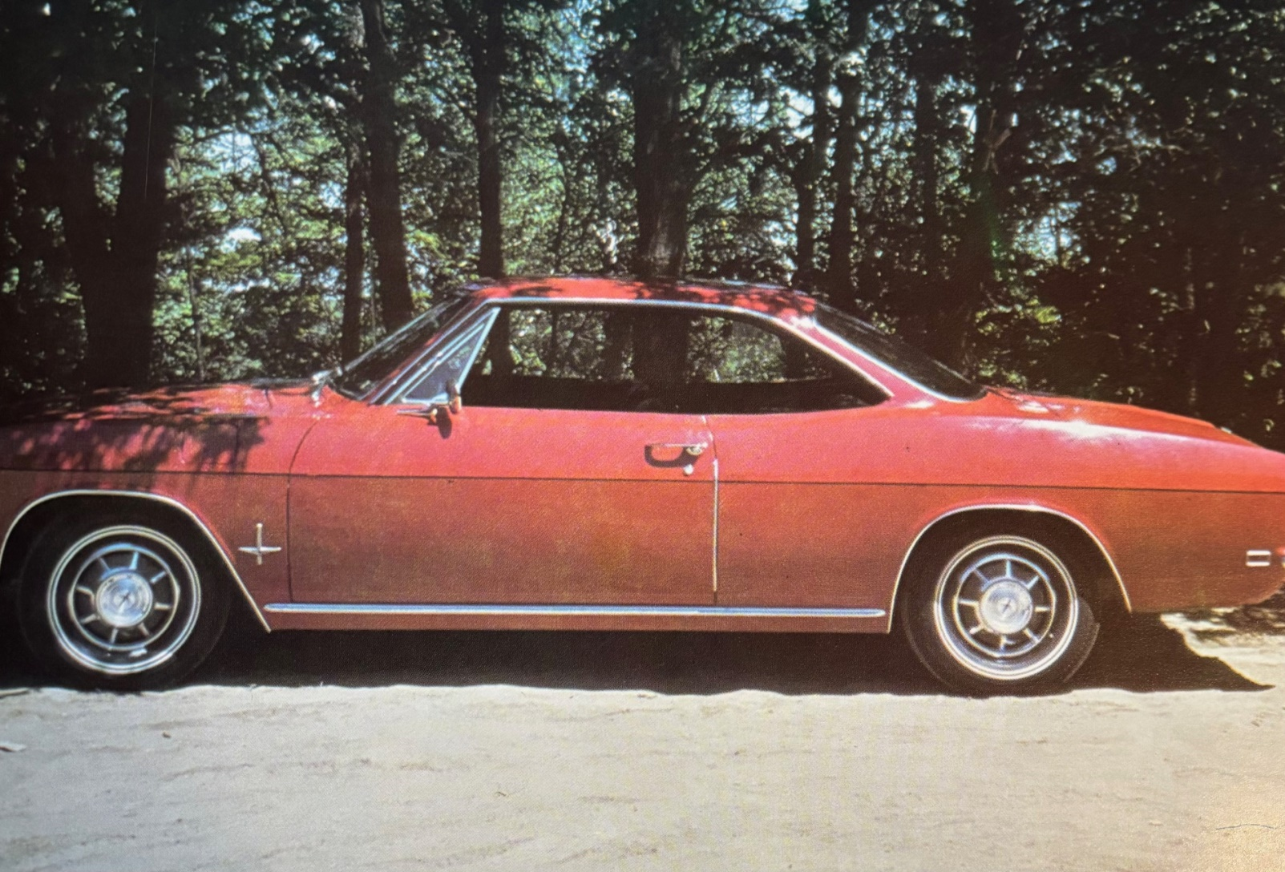
Do you know what this is?

Slide 7
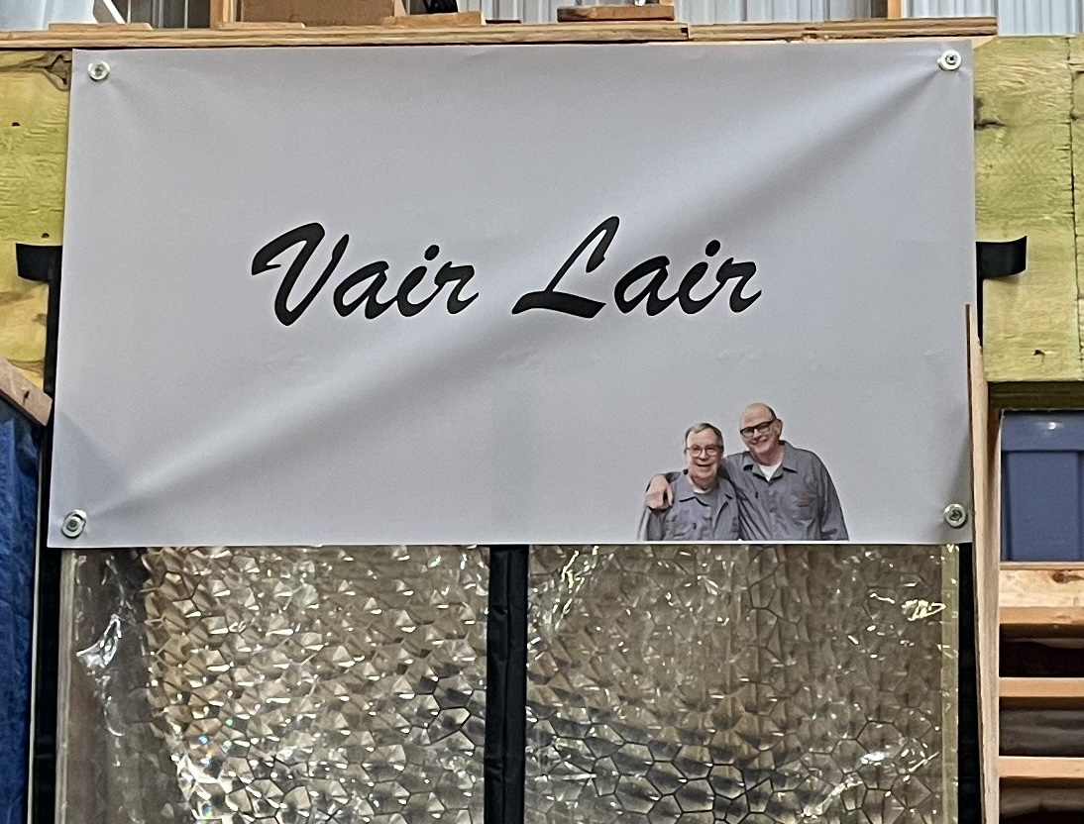
The Shop

Slide 8
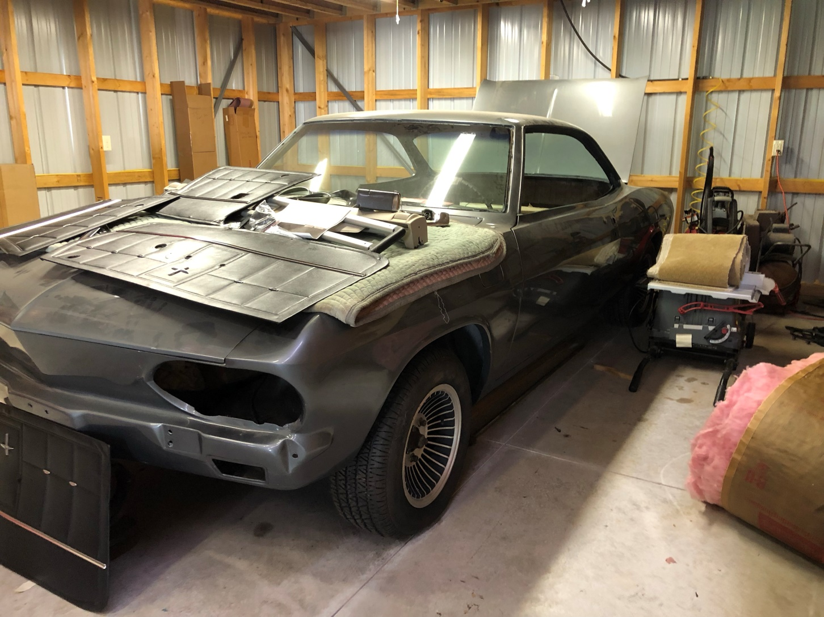
Before the adventure begins

Slide 9
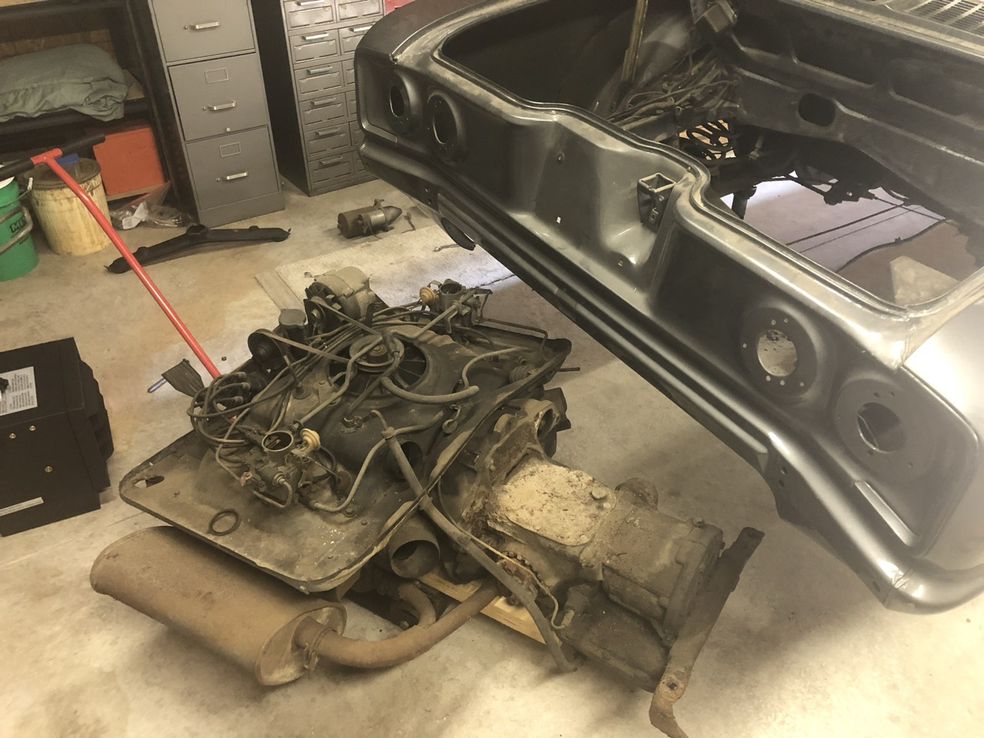
Drivetrain Removal

Slide 10
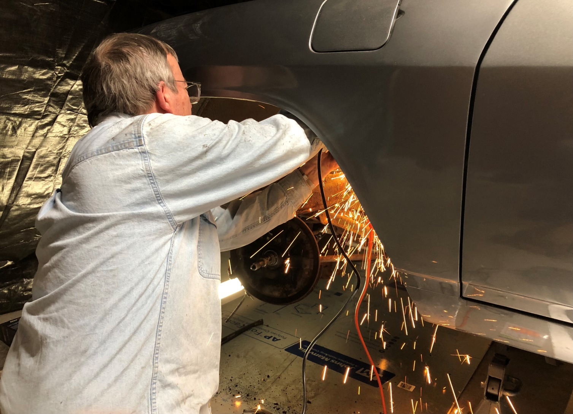
Front Suspension Disassembly

Slide 11
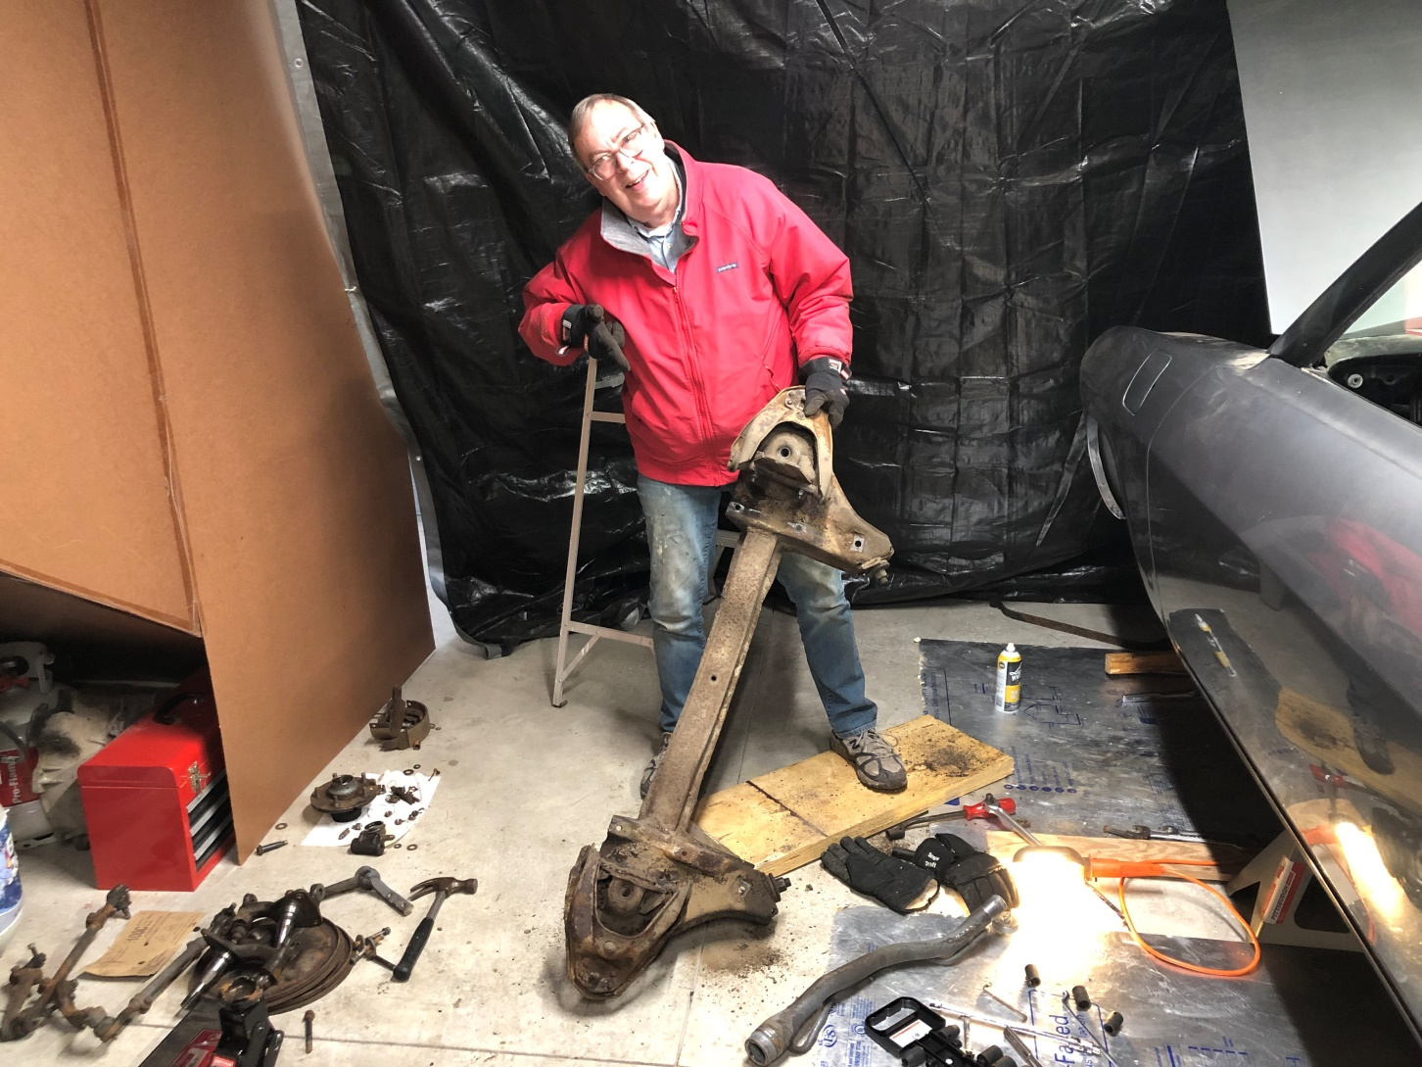
Suspension Out

Slide 12
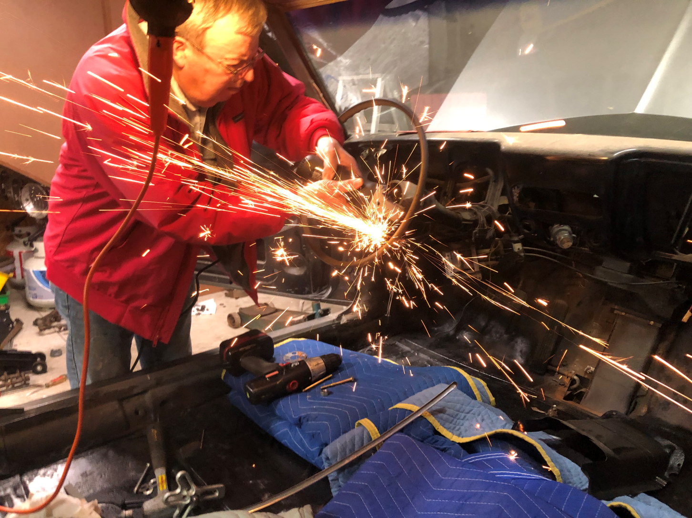
More Sparks – steering removal

Slide 13
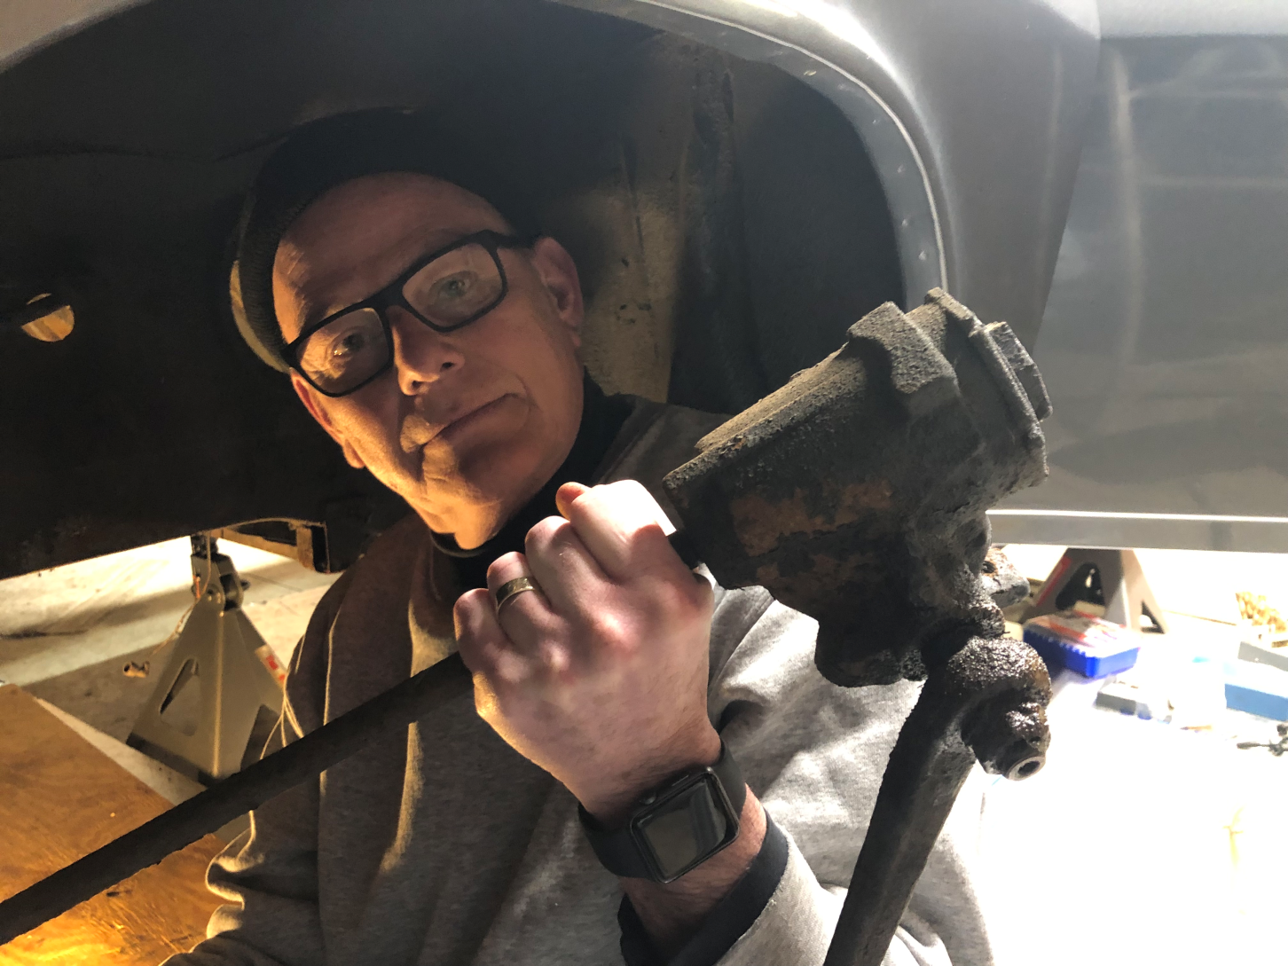
Doug with Steering Out

Slide 14
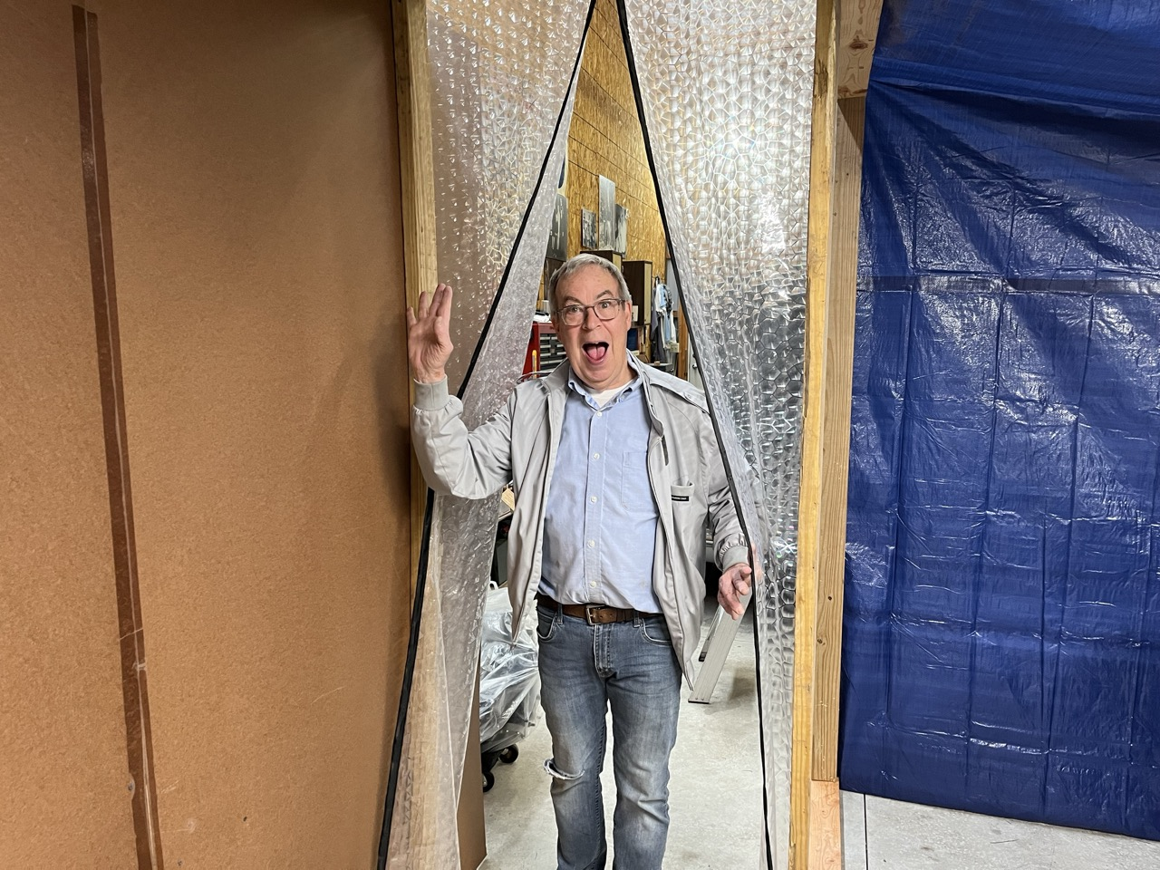
Yearning for Warmth – a major improvement

Slide 15
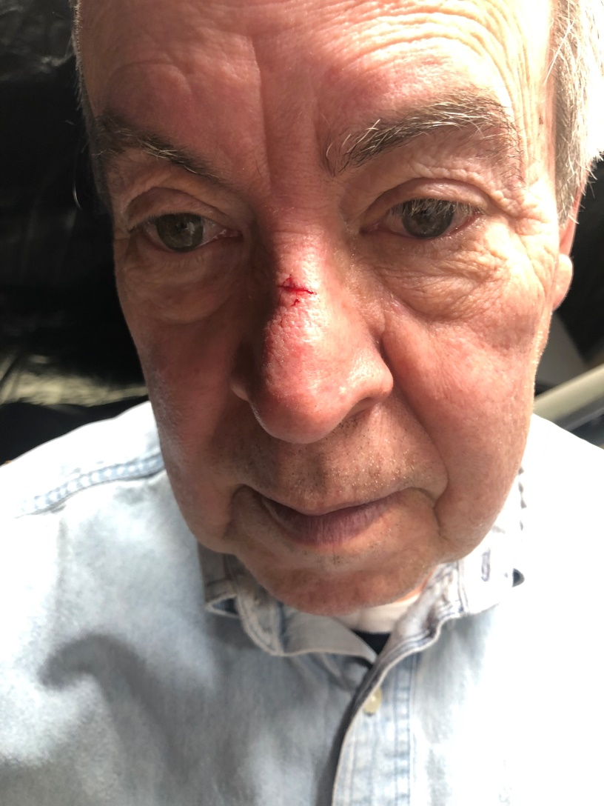
OUCH!!!

Slide 16
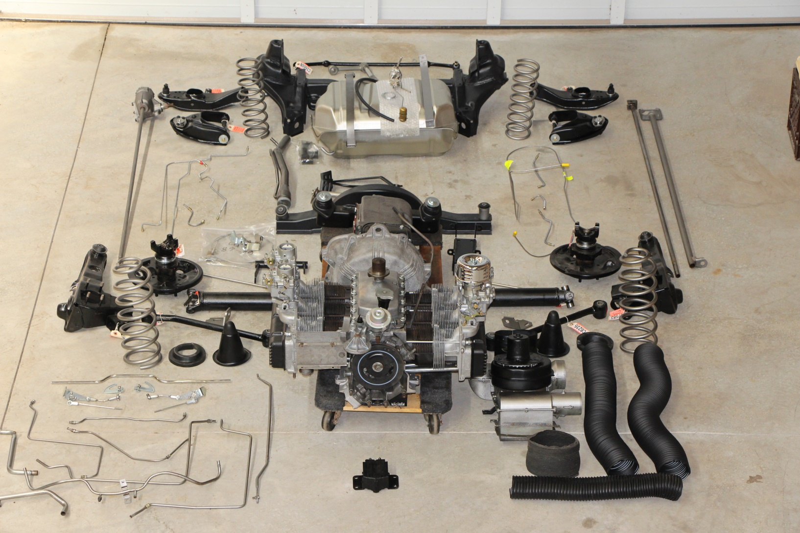
New Parts Layout - @50%

Slide 17
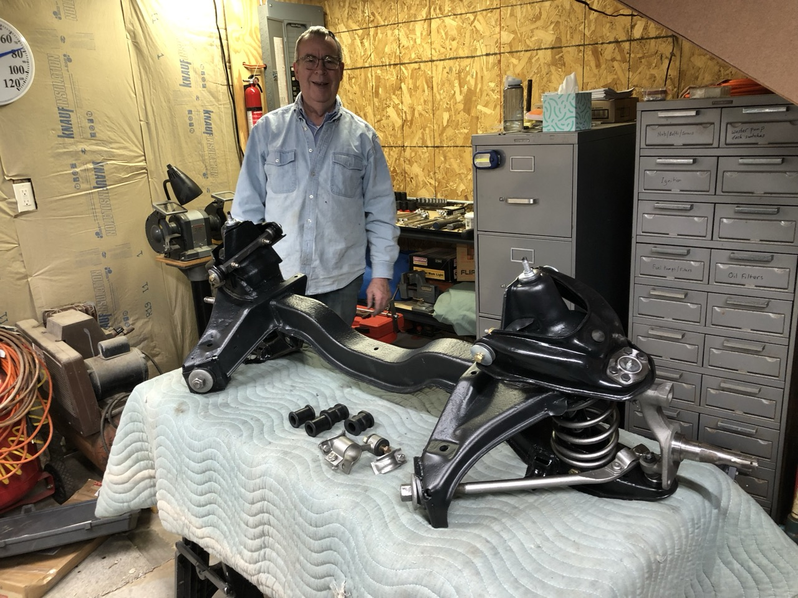
Rebuilt Front Suspension

Slide 18
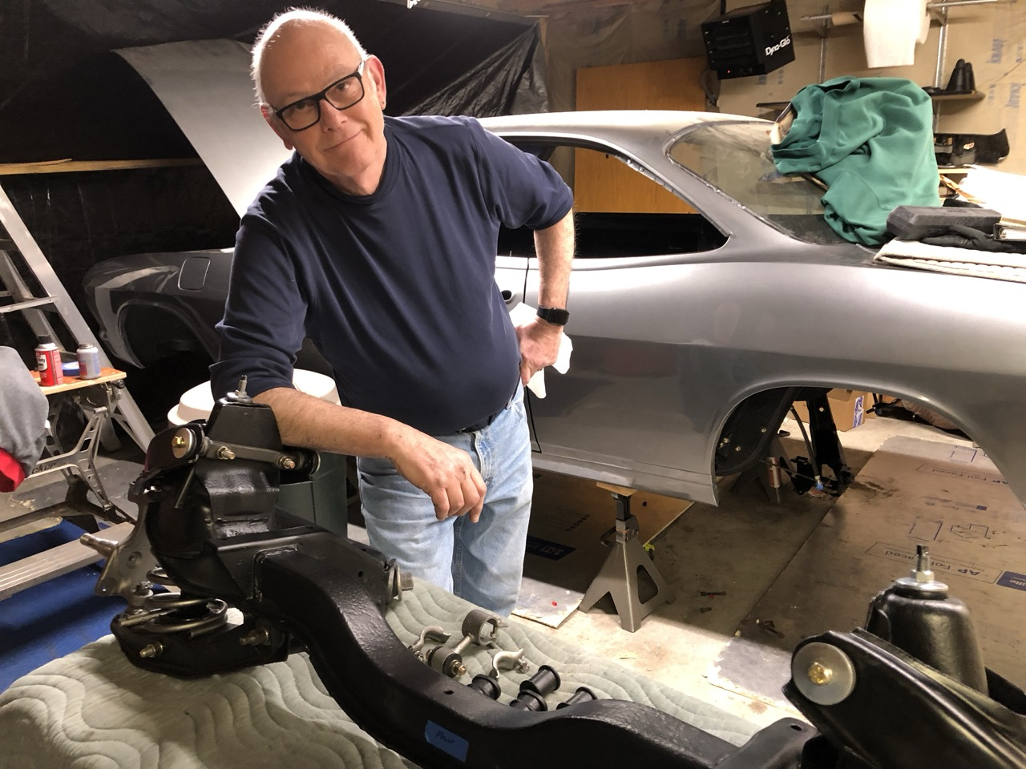
How Angelic!

Slide 19
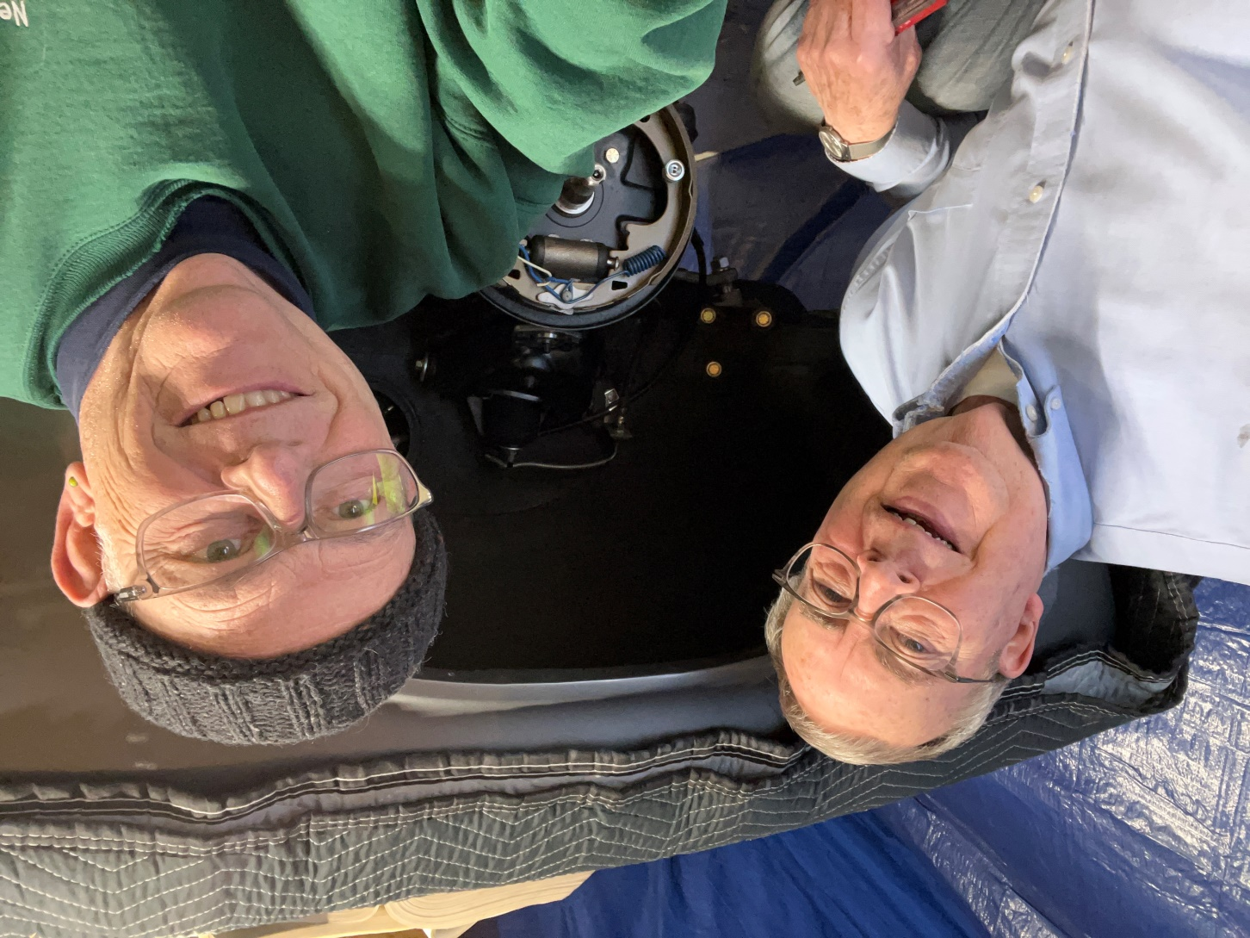
New Brake System Complete

Slide 20
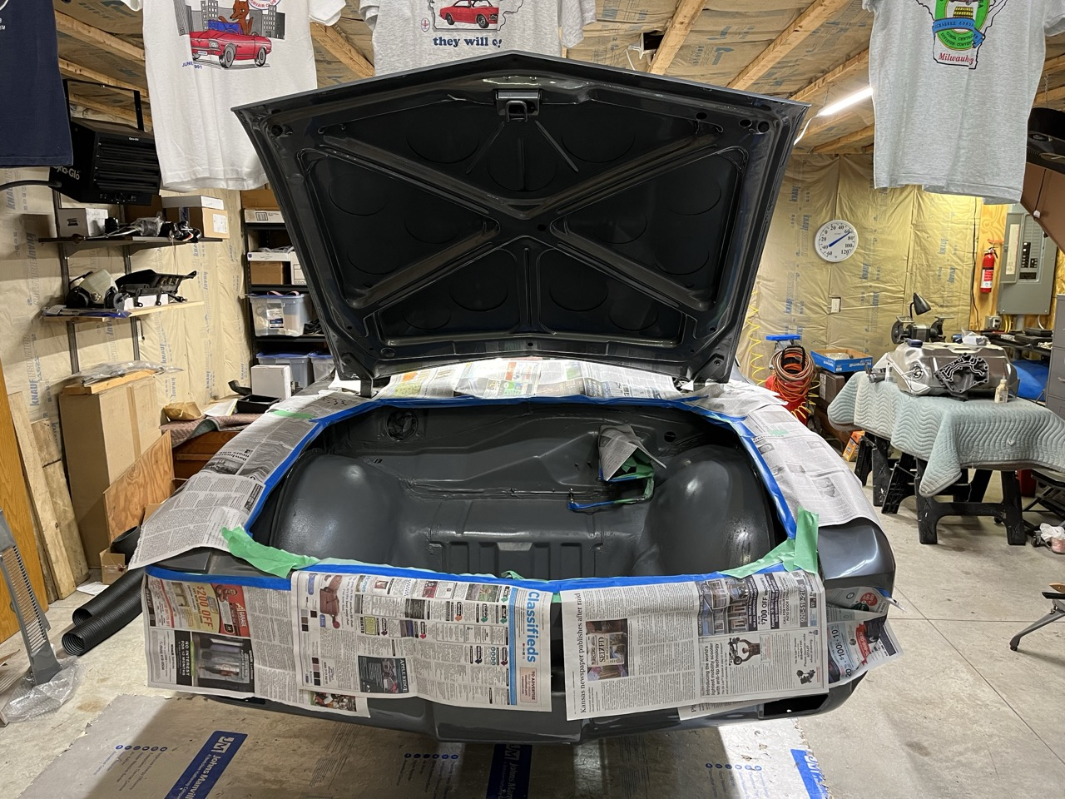
Trunk Painting Diversion

Slide 21
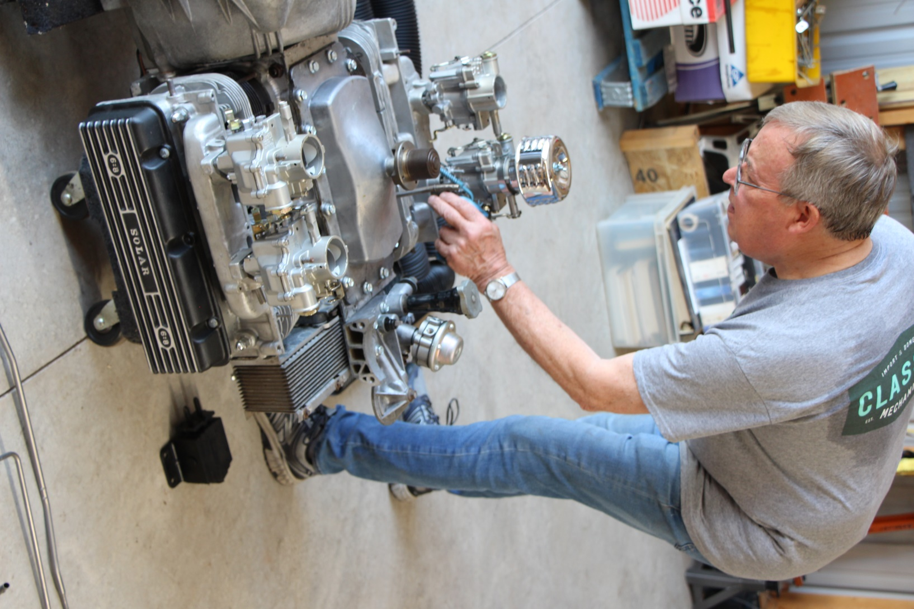
The HP Engine

Slide 22
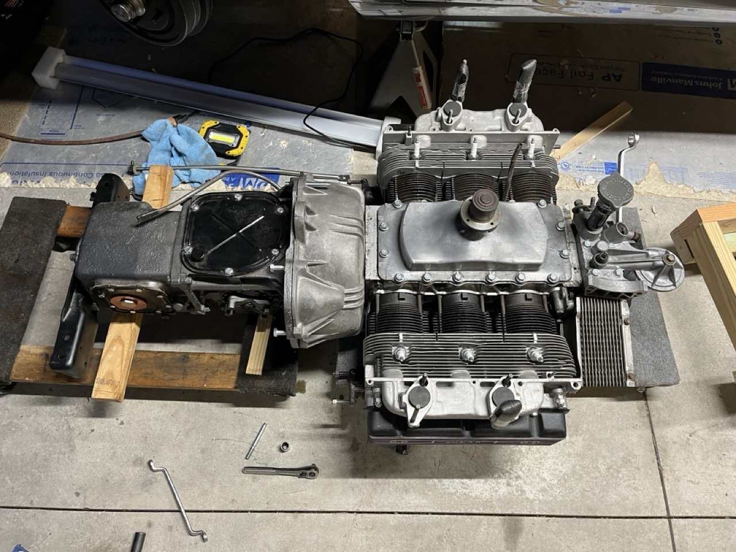
Powertrain Assembly

Slide 23
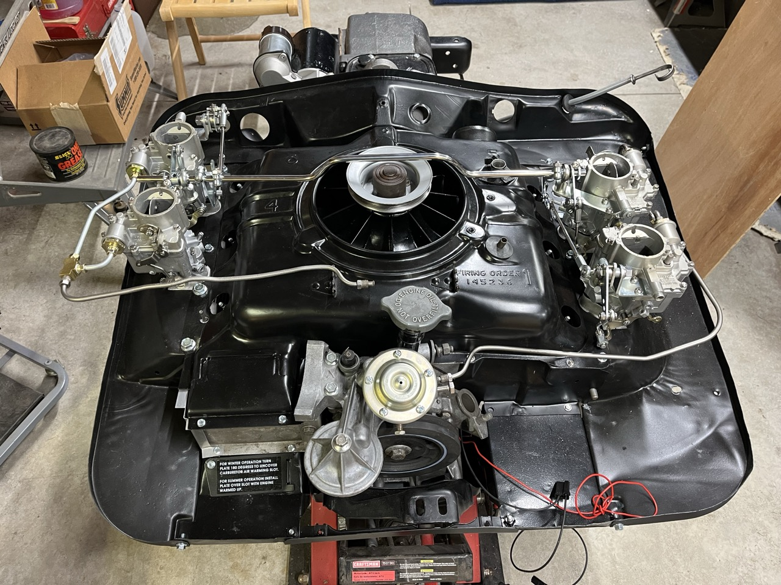
Ready to Install

Slide 24
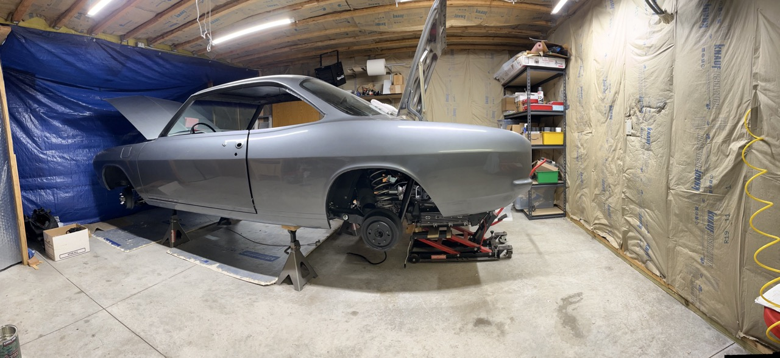
Powertrain Loaded on Lift

Slide 25
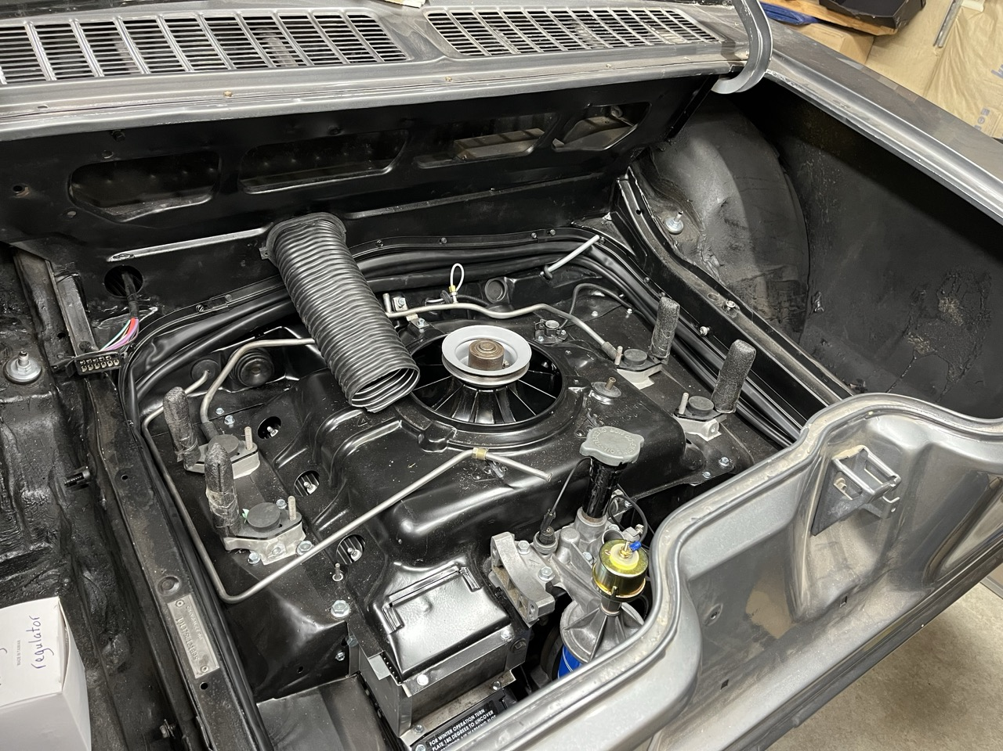
All In!!!

Slide 26
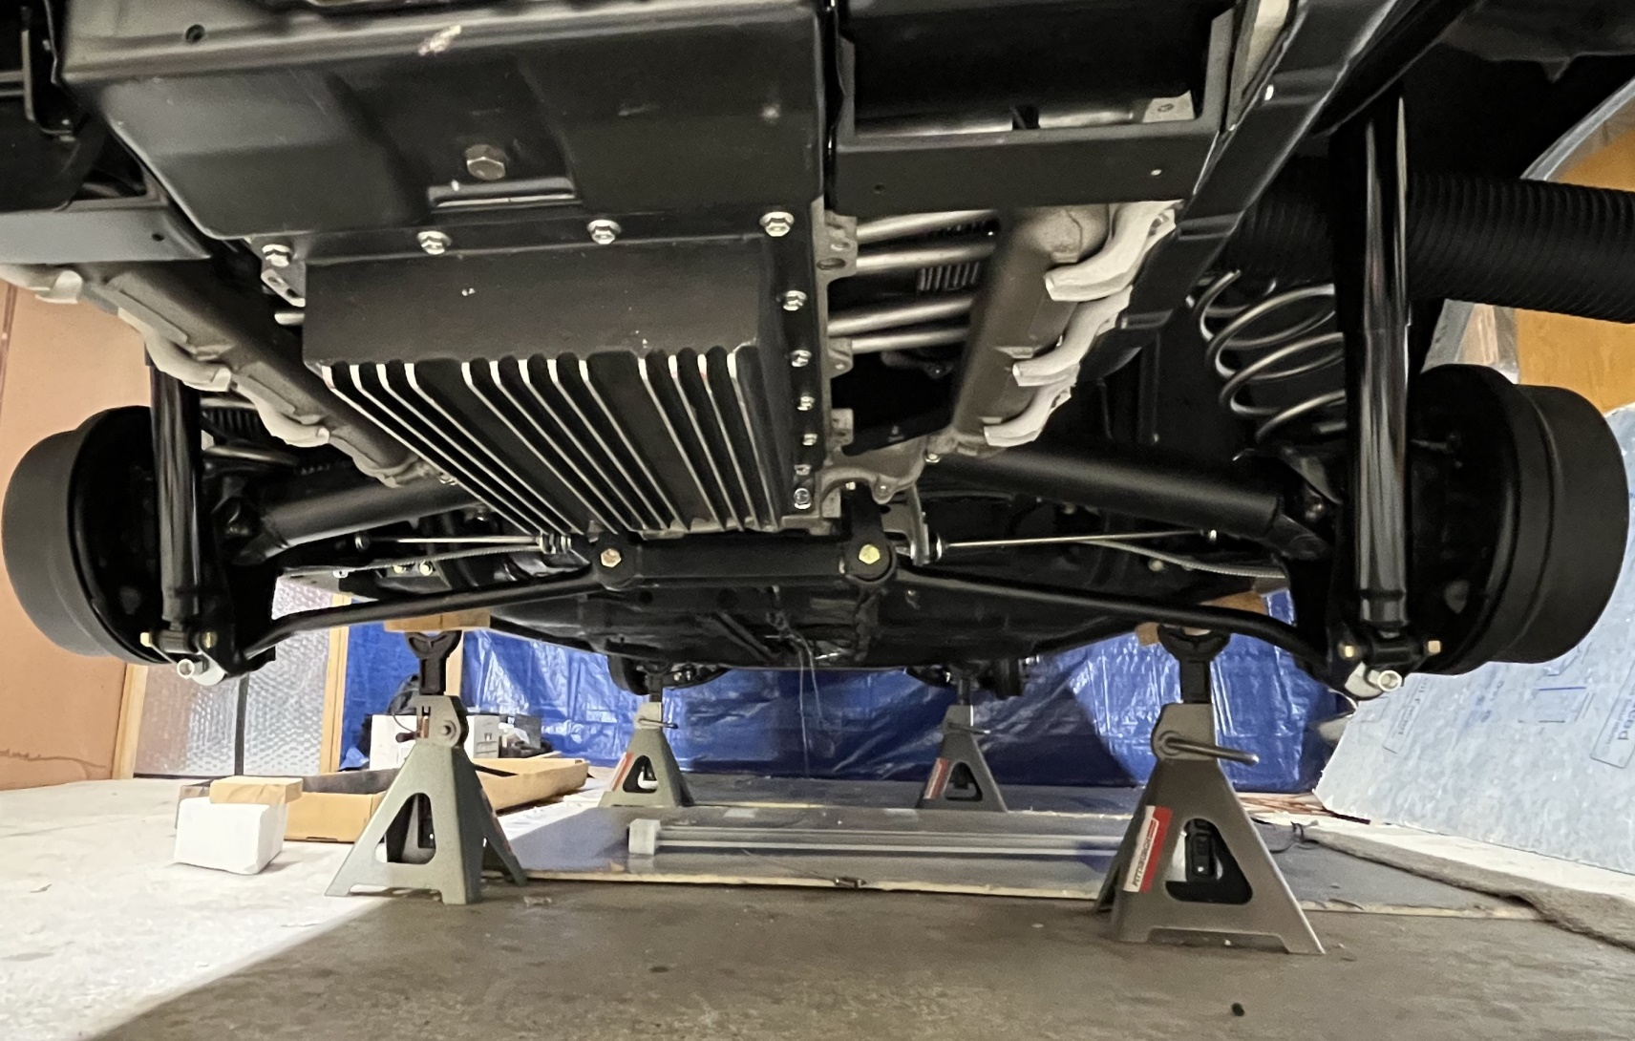
Rear Suspension complete

Slide 27
So, what about ROI?
Years ago, Doug (while talking about guitars and related equipment) told me that “a hobby does not require a return on investment”. Spoken from experience and wisdom.
What has been invested?

Slide 28
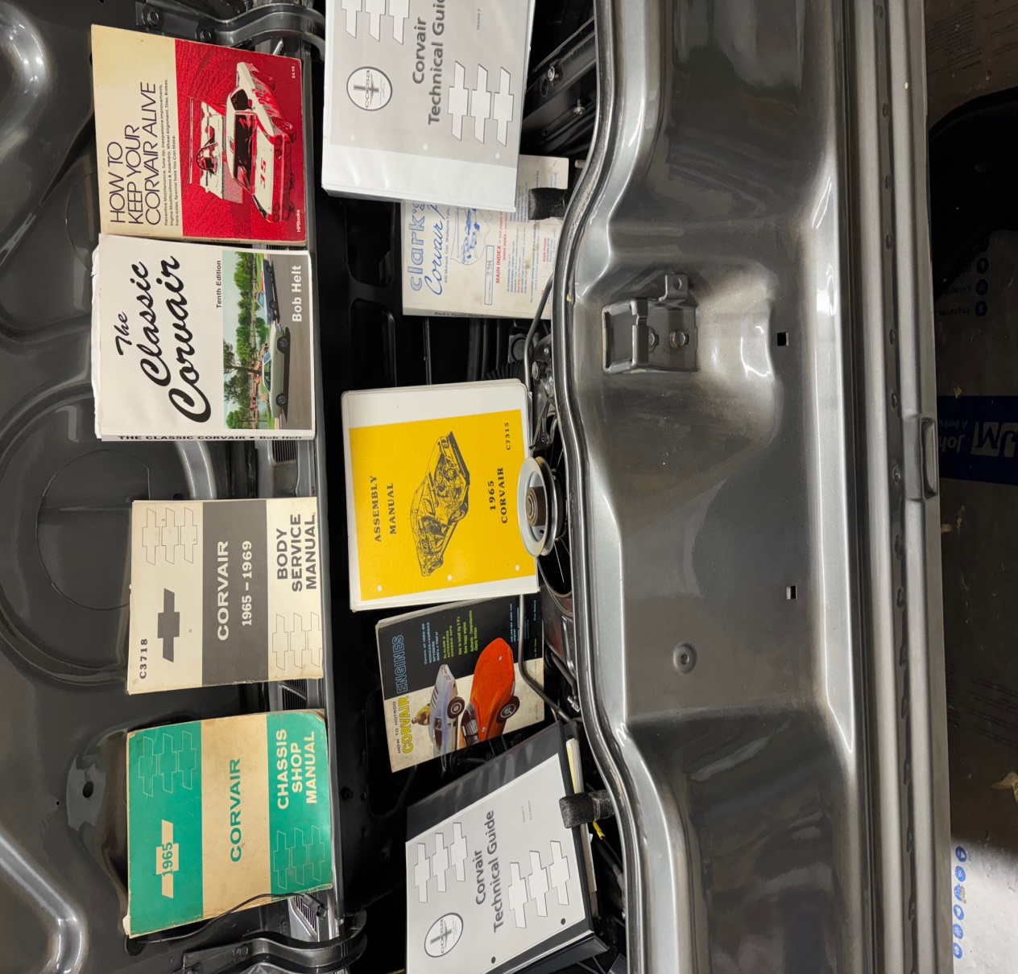
What has been used?

Slide 29
What has been “spent”?
$2,500 at Sassy’s/Wishing Well for 101 lunches
$11,000 at Clark’s Corvair Parts
$10,000 for initial purchase, painting and engine building
$3,000-4000 on miscellaneous parts and services
720 joint work hours; 150 solo work hours

Slide 30
What else is of value?
At Valley New School, the project process focuses on research, learning, overcoming obstacles and personal analysis/reflection. All of these components have been front and center during this journey.
Friendship/mutual support
Confidence/knowledge
Mingling
Personal satisfaction

