Slide 1
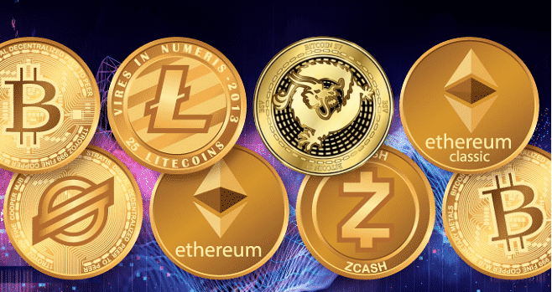
Cryptocurrency
Notes:
Tonight’s topic is crptocurrency.
I’m curious, has anyone here ever used bitcoin or any other cryptocurrency?
Let’s suppose that I owe you $100.

Slide 2
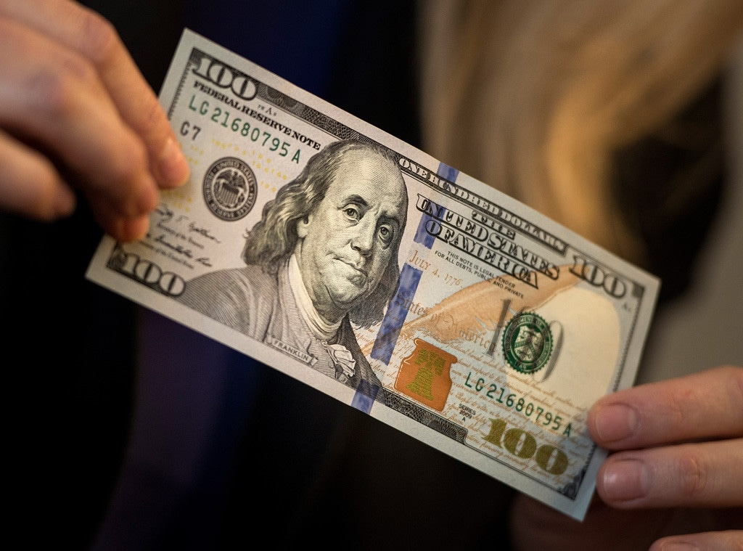
Payment in Cash
Notes:
I could simply give you $100 in cash, and that would be that.
However, I’d have to go to my bank or an ATM or my mattress to get the cash, and we’d have to be in the same place at the same time so I could hand you the money.
Or, we could use a secure carrier to transport the money, but is there really such a thing as a secure carrier? And unless you gave me a verifiable receipt, I would have no proof that I paid you.
You might then want to go to your bank or an ATM to deposit the money into your account. A lot of activities would be required, and a lot of organizations would be involved that would have their hands out for a fee, be subject to hacking, and provide tracking about the transaction which we may or may not want.

Slide 3
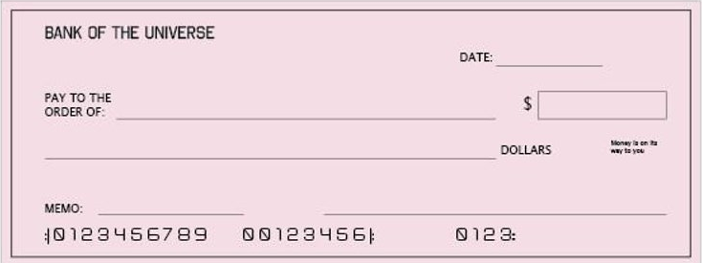
Payment by Check
March 1, 2026
$100.00
You
One Hundred and no/100~~~~~~~~~~~~~~~~~~~
Repay debt
Me
Notes:
Alternatively, you might agree to accept a check as payment. I would still have to figure out how to securely get the check to you. Once you received the check, you might want to deposit it into your bank account and that could require a trip to your bank or an ATM or using an app on your phone.
If I in fact have $100 in my account, the transaction could go fairly smoothly. However, if I am short or don’t even have an account, things could get ugly in a hurry. You would need to contact me to try to get payment, and both your bank and my bank would probably charge hefty fees to process a bad check. Even if you did eventually get your money, a significant amount of time is likely to elapse and a lot of hassle could be involved.
In any case, fees would be charged at several steps in the process and, as with cash, the transaction would be easily trackable.

Slide 4
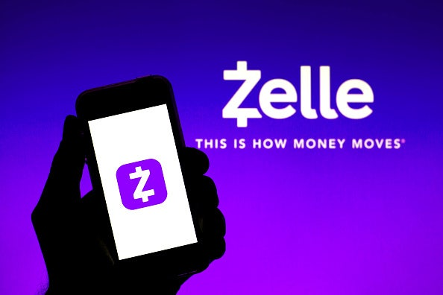
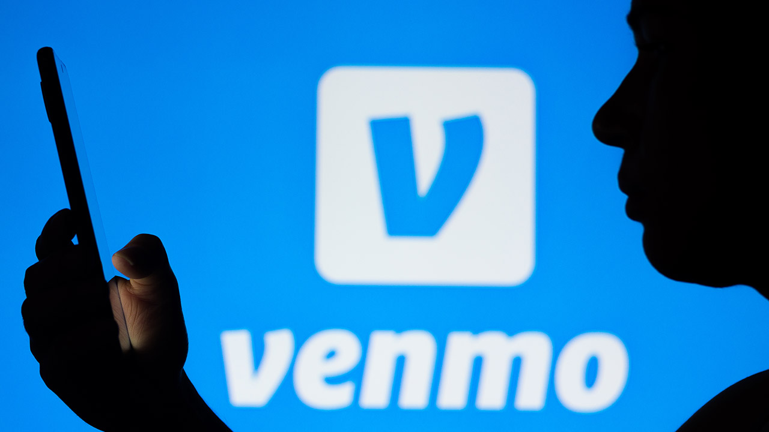
Payment by App
Notes:
We might agree to use a person-to-person payment app such as Venmo or Zelle. These can move money directly from my bank account to yours but would require both of us to give these apps access to our accounts. We would need to communicate certain information to each other about our accounts so that the money could be sent from and to the correct place.
Assuming that we both know how to do it, this is fairly fast, but once you give an app like that access to your account, you need to realize that hacking can and has occurred. Also, fees would be charged and the transaction would be trackable.

Slide 5

The Invention of Bitcoin
Pseudophoto of Satoshi Nakamoto, the pseudodym for the inventer of Bitcoin who remains unknown.
Notes:
In 2009, partly in response to the mistrust of banks created by the 2008 economic crisis, partly from annoyance at transaction fees, partly in a desire to speed the transfer of money, and partly to attain greater security and anonymity, Satoshi Nakamoto, the pseudonym of the still unknown creator of cryptocurrency, released Bitcoin.
He strove to show that another type of currency is possible, allowing for international and decentralized use without relying on any financial institutions.

Slide 6
What is Cryptocurrency?
Cryptocurrency is a digital currency that uses cryptography for security.
A DIGITAL CURRENCY is one that exists only as ledger entries.
CRYPTOGRAPHY secures information in the ledger by using coded algorithms to make them unreadable.
Ledger
Encryption
Encrypted entry
Decryption
Encrypted entry
Encrypted entry
Notes:
Cryptocurrency is a digital currency that uses cryptography for security.
A digital currency is one that exists only as entries in a ledger. There are no physical coins or bills or certificates involved and nothing that has real value such as stock or real estate. It only exists as leger entries.
Cryptography secures information in the leger by using coded algorithms to transform entries into an unreadable format in a process called encryption and back again in a process called decryption.
This ledger in cryptocurrency is decentralized, meaning it is not controlled by a central authority like a government or financial institution. There are many copies of the ledger, and it exists on a decentralized network using a technology called blockchain to record and verify transactions.

Slide 7
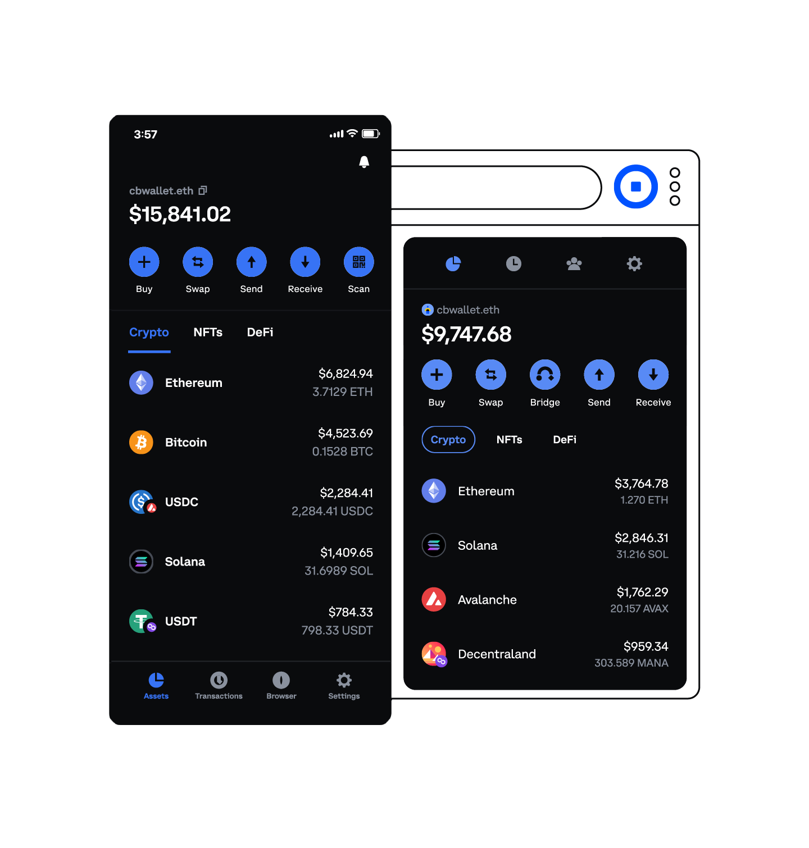
Crypto Wallets
Crypto wallets are apps used to store and manage the cryptographic keys that provide access to cryptocurrencies.
Coinbase Wallet sample screen
Notes:
If you had agreed to accept crypto in payment for the $100, you and I would both need to have crypto wallets.
Crypto wallets are apps used to store and manage the cryptographic keys that provide access to cryptocurrencies. They do not hold the actual currency, but allow you to interact with the blockchain network to send, receive, and manage your funds securely.
Examples of crypto wallets are Crypto.com, Tangem Wallet, and Coinbase Wallet. Most wallets work best on cell phones, but there are some that work on PCs or Macs.

Slide 8
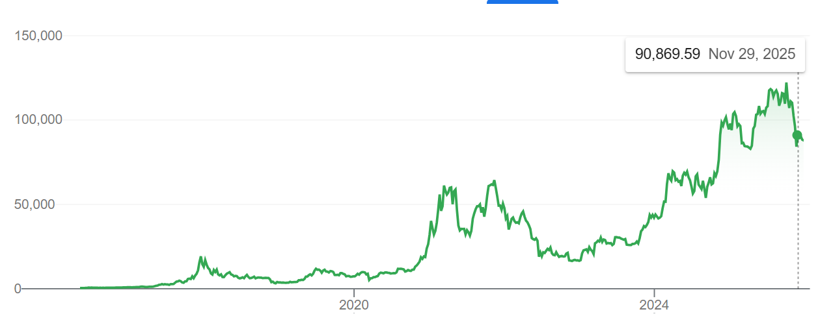
Crypto Price
Bitcoin Price Over Time
Notes:
The price of crypto can change rapidly based upon supply and demand and market sentiment. Accepting crypto is more like agreeing to accept stock shares for payment than it is like accepting money. That is why some prefer the term cyptoassets to cryptocurrency.
The price can vary significantly between the time you agree to accept it and the time you get it. So how do I know how much crypto to send you to cover my $100 debt? Well, actually, I don’t. I can look up the current value of my crypto on a cryptocurrency exchange, and my wallet will probably convert dollars to crypto for me, but you and I will have to agree that we will use the price at a particular time knowing that the dollar value of the crypto you actually receive could be more or less when the transaction is actually confirmed.

Slide 9
Crypto Addresses
1LMcKyPmwebfygoeZP8E9jAMS2BcgH3Yip
Sample Bitcoin Address
Notes:
Every crypto holder has both a public and a private wallet address. These are strings of letters and numbers, usually at least 30 characters in length. Your public address is analogous to your email address or phone number. It is what someone would use to send crypto to you. Your private address is analogous to your password. It must be included in transactions to make them valid, but it is encrypted and can only be viewed when securely decrypted. It is important to know that public addresses are specific to a particular type of crypto currency. Although Bitcoin is the first and largest crypto currency, it is by no means the only one.
Before you can send someone crypto, you must get their public address for the type of crypto you will be sending them. They will usually go to their wallet and copy their public address and paste it into an email or text message that they will send to you. It is really important that this be done correctly. Sending crypto to an invalid address or to the address for a different kind of crypto can result in an irreversible loss of funds. There is no central financial institution that can bail you out. That is why it is strongly advised that you send a small test amount to someone before you send a significant amount of bitcoin.
In fact, in 2013, a British engineer named James Howells lost access to a fortune in Bitcoin after his partner accidentally threw away a hard drive containing private keys to 8,000 Bitcoins. The current value of his loss is at least three quarters of a billion dollars. In spite of considerable research and dumpster diving in the Docksway landfill in Newport, Wales, he was unable to recover his loss.

Slide 10
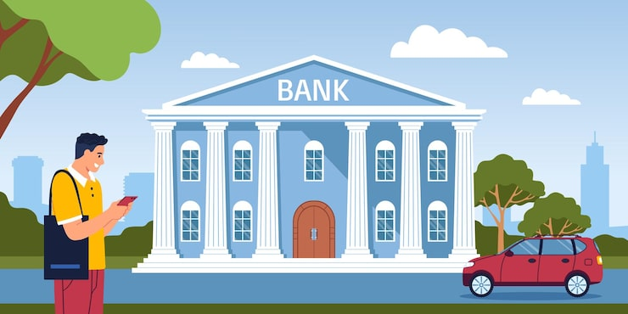
Putting Money in Your Crypto Wallet
Link Bank Account to Crypto Wallet
Notes:
In addition to transferring crypto to someone else, you can buy or sell crypto through your wallet. This is very similar to, for example, buying stocks or mutual funds online.
First, you add dollars to your wallet. This could be done with a debit card, by linking your bank account, or by accessing money in a non-crypto wallet such as Google wallet. Once you have money in your wallet to pay for the crypto, you can just enter a transaction to buy whatever type of crypto you want to buy. You will then have a balance in your wallet for that type of crypto that you can use to sell, to pay for things, to trade for another type of crypto, or to hold as an investment.

Slide 11
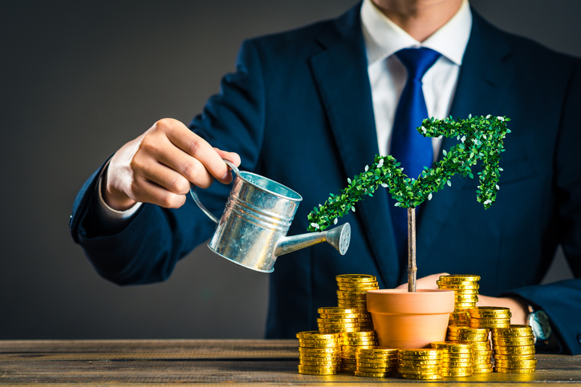
Crypto as an Investment
Very Volatile and Unsecured
Notes:
We have talked about using crypto to pay for things, and that is definitely something you can do. However, there is little doubt that what got people excited about crypto is using it as an investment. We have already talked about how you buy crypto, so to use it as an investment you simply hold onto it rather than selling it or using it to pay for something.
Crypto is very volatile and often has periods of spectacular growth and crashes, but if you had bought $1,000 worth of Bitcoin in 2010, it would have been worth about $1.37 billion in August of 2025. That got people’s attention.
But why should something that exists only as an entry in a ledger appreciate or depreciate? Well, at a very basic level, something is worth what someone is willing to pay you for it. Crypto is definitely affected by supply and demand. At any given time, there is a fixed number of crypto assets in existence, and the rate of growth is strictly controlled. So, crypto is a good investment if you think someone will pay you more for it tomorrow than you will have to pay for it today. Why would they do that? Basically, because they think someone will pay them still more for it the day after tomorrow than they would have to pay you for it tomorrow.

Slide 12
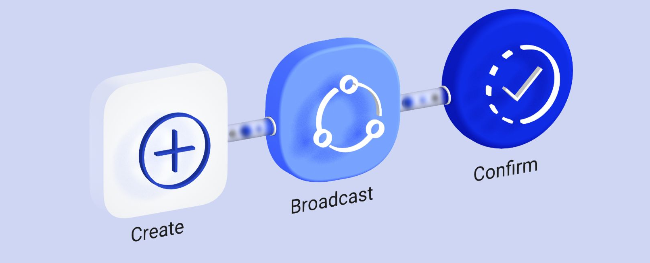
Processing a Bitcoin Transaction
Notes:
So, what actually happens when I go into my cyrpto wallet and indicate that I want to transfer $100 worth of crypto, say Bitcoin, to you. I’m going to now go into the weeds a little more than some of you may want, but I feel like you need some idea of how this works to understand what it is and, frankly in my opinion, how crazy and insanely wasteful of resources it is.
The first requirement would be for you to send me your public Bitcoin address, because that’s where I will send the Bitcoin. I would store this address under your name in my wallet.
I would then enter the tranfer transaction into my wallet indicating that I want to transfer $100 worth of my Bitcoin to you. My wallet would look up the current price of Bitcoin and translate the $100 to a corresponding quantity of Bitcoin. There is also a transaction fee that we’ll talk about in a minute. That would also be added to the Bitcoin amount I need to have.
Bear in mind that the price of a single bitcoin is around $90,000, so I’m going to be sending you something like 0.001111 bitcoins.
Processing a Bitcoin transaction involves three major phases: Creating or Signing, Broadcasting and Confirming.

Slide 13
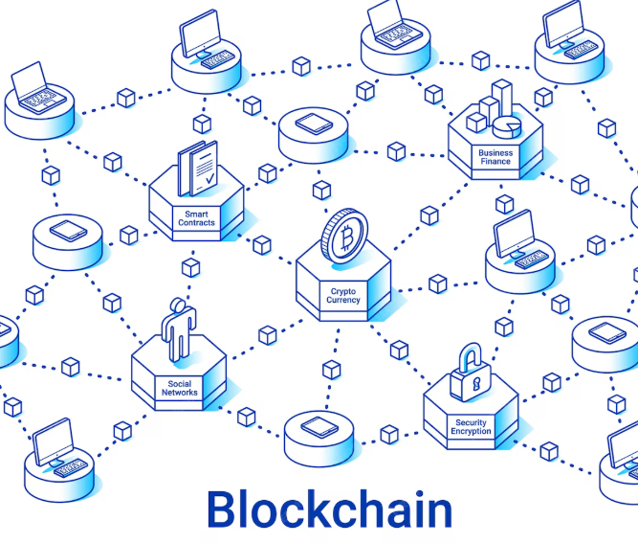
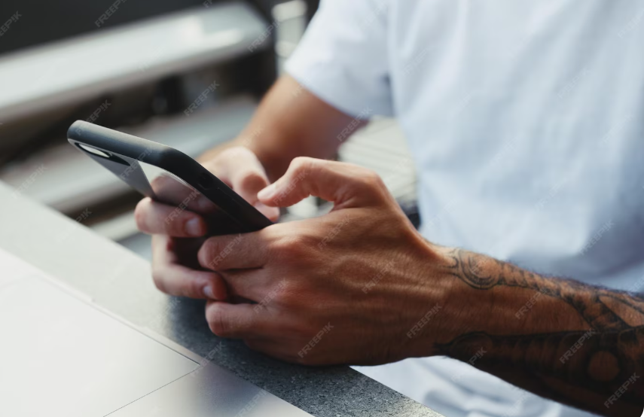
Signing or Creating Phase
UTXOs
(Unspent Transaction Outputs
Inputs (proof you have the crypto)
Outputs (recipients public keys)
Transaction Amount
Transaction Fee & “tip”
Cryptographic Hash (fingerprint)
Your encrypted private key
User enters Send transaction into their crypto wallet
Transaction File
Notes:
I enter the amount of the transaction, the recipient and the priority I want to assign to the transaction. I then click Send, and my wallet creates a unique digital signature for this message by encrypting it with my private key making the signature for each transaction unique and secure. The wallet then groups all of this into a small file. That’s the end of the Signing phase.
When your wallet creates a transaction, it attaches a fee to it. Larger, more complex transactions get higher fees. Transaction size is mostly based on the number of inputs and outputs, although advanced users can add various types of data to the transaction. So, if my $100 worth of bitcoin resulted from 5 people sending me $20 worth of Bitcoin, each of those inputs has to be included in my transaction.
Usually, a transaction will also have at least 2 outputs; one for the place I am sending the bitcoins and one for where I want any leftover bitcoins returned to. That would usually be my own public address. Fees are also higher when the network is congested. In addition, you select a priority when entering your transaction that is sort of like a tip to ensure that your transaction will have a higher fee and, therefore, get prioritized for processing. Your wallet generates a transaction fee based upon these considerations and attaches it to your transaction file. You pay this fee when your transaction is confirmed.

Slide 14
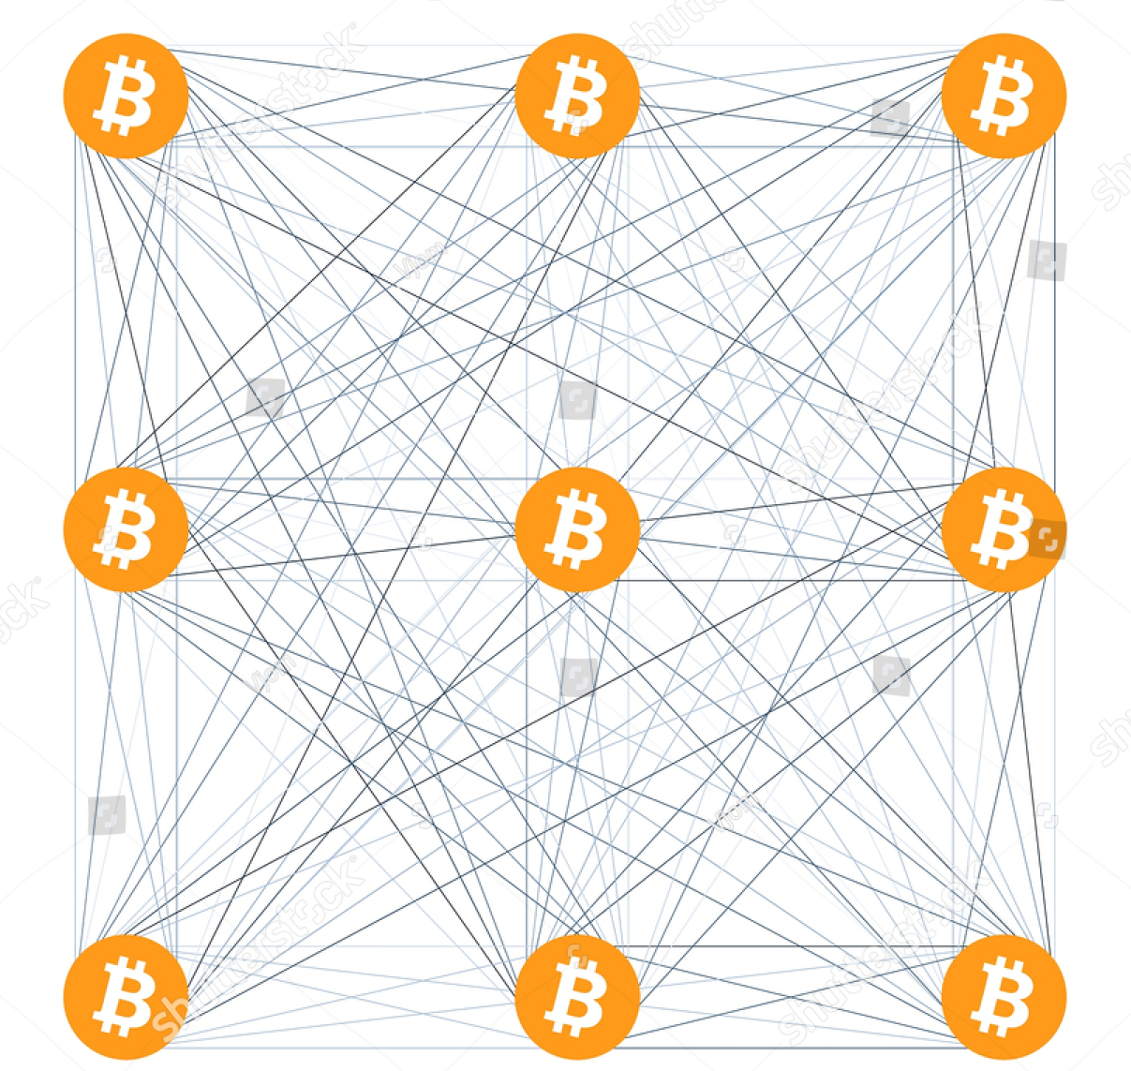
Broadcasting Phase
Transaction File created in Signing phase is sent out to nodes on the Bitcoin network.
Transaction File
Notes:
Your wallet then enters the broadcasting phase. The wallet sends out the file it created in the Signing phase to computers known as nodes that hold a copy of the blockchain which is where the ledger is stored.
Each node receives the file and verifies that it is legitimate by ensuring that I actually have the bitcoins I am trying to send to you. There is no place where my balance is stored in the blockchain. My balance is determined by looking at the entire blockchain of all Bitcoin transactions that have ever occurred that involved my public key to calculate my balance.
The blockchain is currently about 800 GB of data, but that’s what it sorts through. 800GB is large, but it would fit on most solid-state disks that you can plug into a USB port on a computer. My signature is verified based upon my private key to ensure it is valid. This is repeated at each node the file is sent to.

Slide 15
Mempool
Mempool
Mempool
Mempool
Transaction File
Each node validates the transaction file and, if it is valid. stores it in it’s mempool file and sends it on to the next node.
Mempool
Mempool
Mempool
Mempool
Mempool
Mempool
Notes:
When a node receives and validates the file, it puts it into a holding area called the memory pool or Mempool. This area is dedicated to transactions that are valid but have not yet been confirmed. Entry into the Mempool of each validating node ends the broadcasting phase of bitcoin transaction processing.
There are tens of thousands of nodes, and not all of them have to validate the transaction, but if a transaction is determined to be invalid, it isn’t placed in the Mempool and is not propagated to other nodes, so it dies from lack of consensus.
Once a transaction has been determined to be valid and placed in the mempool, its status is unconfirmed. It has been determined to be valid but is not yet in the blockchain. Such transactions can still be cancelled.

Slide 16
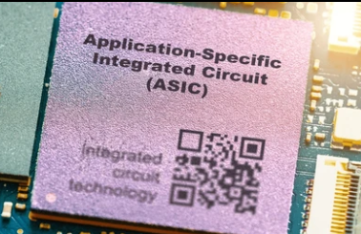
Confirmation
Miners have thousands of ASICS.
They create new blocks from their Mempool and add them to the Blockchain to confirm the transactions in the block.
Bitcoin Miner
Mempool
New Block
Notes:
Once the transaction is in the mempool, it moves on to the final stage of confirmation. This gets into one what, in my opinion, is one of the strangest aspects of cryptocurrency. It is called mining.
There is no exact count of how many bitcoin miners there are, but estimates suggest that there may be more than a million, although some are small hobbyists. The U.S. alone has at least 137 commercial, large-scale mining farms. When I say large, I mean huge. Each has thousands of computers called AICS which stands for Application-specific Integrated Circuits.
Miners take transactions sitting around in mempools, group them together and create a block. A block has a limited size of about 2 megabytes, so the number of transactions that can be placed in a block varies based upon their complexity, but about 3,500 might be typical. Miners prioritize small transactions with high fees so they can make the total fees in the block as high as possible.
Typically, new blocks are added to the blockchain about once every 10 minutes but at times it can be much faster or slower. As more blocks are added to the blockchain, the block containing your transaction becomes virtually impossible to change because the blockchain is duplicated thousands of times. It is, therefore, very secure.

Slide 17
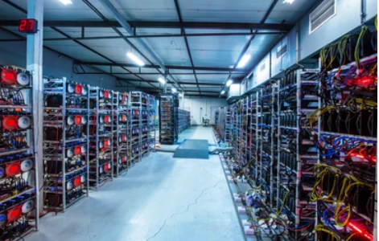
Bitcoin Miners
An Exehash is one quintillion hash calculations per second.
- That’s 1,000,000,000,000,000,000 calculations/second
- Large miners can do 30 Exehashes.
All miners combined use:
- 200 gigawatts of power/year
- 200,000,000,000,000 watts
- 2,200 gigaliters of water/year
- 2,200,000,000,000 liters
- Currently more than AI uses
Notes:
An exahash is a measure of computing capacity. One exahash represents one quintillion (10 to the 18th power) hash calculations per second. Large mining operations have rates of over 30 exahashes.
These AICS require hundreds of megawatts of power and a space of at least 100,000 square feet. For comparison, that’s bigger than Trump’s new White House ballroom which could hold two football fields. All bitcoin miners combined use about the same amount of power as many medium-sized countries such as Thailand or Poland. That’s more than 200 terawatt hours per year.
The global water consumption by bitcoin miners is estimated at over 2,200 gigaliters annually which is equivalent to the amount of water used by hundreds of millions of people in developing countries or major cities. This water is used primarily to cool the computing and electricity generating equipment.
The picture shows the inside of one building. There might be 15 or 20 such buildings in one mining farm. As of late 2024, crypto mining used more energy than AI, although AI is growing faster and may surpass crypto.

Slide 18
Why Do Miners Need All That Power?
To be the first to guess a random number!
The first miner to solve a complex calculation gets to add the block to the blockchain. None of the other miners do.
Calculation
Take the calculation result and timestamp from the last added block.
Add a random number called a nuonce to it.
Run it through a hashing function called SHA-256.
Check if the hash produced is less than or equal to the network target hash.
If no, try again
If yes, broadcast the result called proof-of-work to the network and add a block.
Notes:
The reason these miners need so much computational power is that they actually compete to see who gets to add a new block to the blockchain. In order to win, the miner must be the first so solve a complex calculation. If it is, then all of the transactions in the block they add will be considered confirmed. Other transactions may have been added to a block by other miners, but if they didn’t win the competition, then those transactions will remain in a validated but not confirmed state in mempools.
The calculation that must be solved involves taking the calculation result from the last-added block and its timestamp and adding a random number called a nonce to it. Miners run this combined number through a cryptographic hashing function called SHA-256 which creates a unique, 64-digit string called a hash. This hash must be less than or equal to a target hash set by the network. This target hash is adjusted by the network about every two weeks to cause new blocks to be added to the blockchain about once every 10 minutes.
If the hash produced by the random number the miner chose is greater than the network target, then a new random number is used to try again. This is repeated trillions of times a second. If a number is found that creates a hash less than the network target, the miner broadcasts the solution called proof of work, the network verifies it, and the miner adds its new block of transactions to the blockchain.

Slide 19

Reward for Adding a Block
Reward
The fees from all of the transactions in the block you added.
3.125 Bitcoins
3.125 Bitcoins
Bitcoin Miner
Transaction Fees
New Block
Notes:
As a reward for their work, the winning miner not only get the fees associated with the transactions in their block, but they receive newly minted bitcoins.
Currently, the reward is 3.125 bitcoins per block added which is worth something like a quarter of a million dollars depending on the current price for bitcoins.
In addition, they get the fees for the transactions in the block they added. These vary wildly, but are usually less than $10,000 although in some circumstances they could be 10 times that much.
So, all that computing power, electricity, and water usage are for trying to be the first to guess a random number that will win you some bitcoins and fees.

Slide 20
Decreasing Rewards
Number of Bitcoins awarded for adding a block is halved about every 4 years
2009 – 50 Bitcoins
2012 – 25 Bitcoins
2016 – 12.5 Bitcoins
2020 – 6.25 Bitcoins
2024 – 3.125 Bitcoins
No more than 20 million Bitcoins will be created.
Notes:
Interestingly, the reward for adding a block to the blockchain is cut in half roughly every four years until the number of bitcoins reaches 20 million at which point no more bitcoins will be added. This is expected to happen about 2040.
In 2009, miners got 50 bitcoins per block added. That decreased to 25 in 2012, 12.5 in 2016, 6.25 in 2020, and 3.125 in 2024 which is the current payoff.
This scale is designed to make bitcoin deflationary and scarce.

Slide 21
Block Explorers
Block explorers interrogate a blockchain to retrieve information.
Balances
Transaction status
Network statistics
Notes:
There are programs called block explorers that allow you to search through the blockchain to determine the balances for different public addresses, track specific transactions and get statistics about the network, so you could use one of these to see where my attempt to pay you in bitcoin stands.

Slide 22

Becoming a Miner
You would be competing with operations that have tens of thousands of ASICs (Application Specific Integrated Circuits).
Notes:
So why buy bitcoins? Why not just set up your own mining operation and earn bitcoins for adding a block to a blockchain.
Well, actually, you could. It is estimated that there may be a million bitcoin miners, although some of them combine their resources into mining pools to be able to afford competitive setups.
You could mine bitcoins on your cell phone although you would probably need at least one ASIC to have any chance at all. You could download the mining software which would connect you to the network and, presto chango, you are a bitcoin miner.
However, you would be competing with miners that can do 30 exehashes per second, so your odds of ever winning the contest to be the first to solve the calculation are finite but close to zero.

Slide 23

Make Your Own Crypto
Notes:
So, why not just start your own cryptocurrency and give yourself a bunch of crypto free to start off with? Well, you could. In fact, thousands have, but it isn’t simple.
It requires careful planning, technical development, and adherence to legal requirements. You can either create a new token on an existing blockchain which is easier and cheaper or build an entirely new blockchain from scratch which is complex and expensive but potentially has greater rewards.
You would need to document your project idea, technology, and roadmap in a detailed white paper to build investor confidence and provide transparency. You would need to market your cryptocurrency to the area it is intended to help. You might do this with special industry-specific features or lower fees for certain markets.
Basically, it is a lot like starting a new company.

Slide 24
Starting Your Own Cryptocurrency
Crypto Currency
$1.8 trillion
$1.4 trillion
Bitcoin
Altcoin
Other cryptos
Notes:
Bitcoin is the first and largest crypto currency having more than half of the market and a market capitalization of about $1.8 trillion. Another very large cryptocurrency is Ethereum with a capitalization of about $360 billion. All other cryptocurrencies are usually grouped as Altcoins.
Altcoins may have a combined market capitalization of about $200 billion although this number is harder to determine. There are more than 25,000 altcoin currencies. Each has its own miners and own rules. You might invest in these altcoins if you believe there is potential for higher returns than from bitcoins or just to diversify your portfolio.

Slide 25

Crypto Advantages and Disadvantages
Decentralization
Low transaction fees
Fast processing
Enhanced security
Transparency
Extreme price volatility
High energy and water usage
Regulatory uncertainty
Technical complexity
Use for illicit activities
Notes:
Advantages of Cryptocurrency
So, other than investment potential, what are the advantages of using a cryptocurrency? Cryptocurrency offers benefits like decentralization, lower transaction fees for international transfers, faster processing, enhanced security, and transparency. Whether or not this transparency is a good thing depends upon your perspective. If you are a drug cartel trying to move money around or a corrupt government official accepting bribes, transparency is a wonderful thing. If you are the guy whose partner threw away the disk with his crypto wallet, then not so much.
Disadvantages of Cryptocurrency
Crypto suffers from extreme price volatility, high energy use, regulatory uncertainty, security risks from scams and hacks, technical complexity, and potential misuse for illicit activities, making it a high-risk, high-reward asset. Does it have the potential to cause a major disruption to our economy similar to the mortgage crisis of 2008 or even worse? Probably.

Slide 26
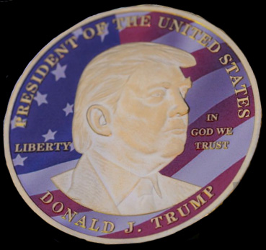
$TRUMP Cryptocurrency
Created about the time of his inauguration
Originally 1 billion tokens, 80% retained by Trump
Currently worth about $700 million
Untraceable, but it is known that Mideastern companies bought millions
Notes:
President Trump and his family created their own crypto currency called, unsurprisingly, Trump about the time of his inauguration. Since they created the crypto themselves, they didn’t have to spend money buying into it. They kept 80% of the tokens for themselves. The currency currently has a market capitalization of about $700 million. Many have considered it an untraceable way to bribe the president in order to be able to receive favors like the best weapons and scarce, highly advanced computer chips.

Slide 27

Nancy Guthrie Kidnapping
At least some of the ransom notes required payment in crypto
Notes:
An example of where being untraceable is a bad thing, at least some of the ransom notes received in the Nancy Guthrie kidnapping case demanded payment in cryptocurrency. It was never determined that the people making these demands actually held Mrs. Guthrie, but the demand for crypto is interesting.

Slide 28


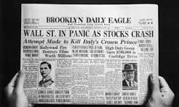
Warnings
Never invest in a business you cannot understand.
Dutch tulip bulb market bubble
1929 stock market crash
Notes:
In conclusion, it is worth remembering a few things.
First, Warren Buffett is widely quoted as saying, "Never invest in a business you cannot understand." Trust me, you probably don’t understand crypto. We haven’t even scratched the surface in this talk.
Second, remember that in the 17th century Netherlands, the prices for rare and exotic tulip bulbs soared to extreme, irrational levels, sometimes exceeding a year’s wages for a single bulb. Many people bought bulbs not for their intrinsic value but with the expectation that prices would keep rising indefinitely. In February, 1637, a greater fool could not be found and the price of tulip bulbs and in fact the entire financial system of the Netherlands collapsed.
Third, remember remember the crash of 1929 largely caused by speculation.
I would also like to say that this is a very complicated topic, and I have no illusions about having answered all of your questions. In fact, I’m certain that I don’t know the answers to all of your questions. I tried to make this presentation accurate, but this is a difficult topic, and I am not a crypto expert. If there are errors, I hope they are minor. But I believe that when you leave here tonight, you wlll be ignorant about crypto at a higher level and about more important topics than when you arrived.
Lastly, Caveat emptor. Let the buyer beware. Thankyou.

