Slide 1
The History of the US Postal Service: Evolution and Impact
Exploring the evolution and significance of postal services
-The story of America revolve around the history of the Post Office
Disclaimer: This content is developed from my research using:
The internet
Microsoft Copilot
The Book – How the Post office Created America by Winifred Gallagher 2016
Personal experience and material
Notes:
AI-generated content may be incorrect. --- The US Postal Service has played a crucial role in American history, evolving from colonial mail systems to a modern institution. This presentation will explore its origins, major milestones, challenges faced, and impact on society and the economy.

Slide 2
Agenda for Discussion
Origins of Postal Services in America
Major Milestones in US Postal History
Challenges and Reforms
Impact on Society and Economy
The Future of the US Postal Service
Notes:
This presentation will cover the origins of postal services in America, significant milestones in its history, challenges and reforms faced over the years, the impact of the postal service on society and economy, and finally, the future prospects of the US Postal Service.

Slide 3
Origins of Postal Services in America
Notes:
The US Postal Service has deep roots in American history, beginning with informal mail systems during the colonial era. Understanding its origins helps us appreciate its evolution over time.

Slide 4
Colonial-Era Mail Systems
Informal Mail Systems
In colonial America, individuals and local merchants often acted as couriers, creating an informal mail network.
Foundation for Postal Service
The informal mail systems set the groundwork for the establishment of a more organized postal service in America.
Community Connections
These informal networks facilitated communication and connections among communities in colonial America.
Notes:
Before the establishment of a formal postal service, colonial America relied on informal mail systems, with individuals and local merchants sometimes acting as couriers. This laid the groundwork for organized postal communication.

Slide 5
Role of Benjamin Franklin
Postmaster General Appointment
Benjamin Franklin was appointed as the first Postmaster General in 1753, marking a pivotal moment in postal history.
Revolutionizing Postal Efficiency
Franklin improved the efficiency of the postal system by implementing better management practices and innovative solutions.
Establishing Postal Routes
He established vital postal routes that enabled faster and more reliable mail delivery across the colonies.
Standardization in Mail Delivery
Franklin introduced standardization in mail delivery, ensuring consistency and reliability for all correspondences.
Notes:
Benjamin Franklin, appointed as the first Postmaster General in 1753, revolutionized the postal system by improving efficiency, establishing postal routes, and introducing standardization in mail delivery.

Slide 6
Formation of the US Post Office Department
Established in 1792
The US Congress officially established the Post Office Department in 1792, marking a pivotal moment in American communication.
National Mail Service Framework
The creation of the Post Office Department established a framework for a national mail service, improving connectivity.
Enhanced Communication
This formalization of postal service enhanced communication across the expanding nation, connecting people more effectively.
Notes:
In 1792, the US Congress established the Post Office Department, creating a framework for national mail service. This formalization allowed for greater connectivity and communication across the expanding nation.

Slide 7
Major Milestones in US Postal History
Notes:
The US Postal Service has undergone significant changes throughout its history, marked by key milestones that have enhanced its functionality and reach.

Slide 8
Much of the story of America revolves around the history of the Post Office
As the Colonies formed the Crown instituted its own Postal service
Mostly a source of revenue for the King
Used mainly by the rich, royalty and British Gov
Ben Franklin appointed one of the first Post Masters by the Crown
The founders quickly understood the importance of communications throughout the Colonies
By the 1760’s Colonial news eclipsed Europeon news in Importance
Newspapers began to flourish
British Stamp Act of 1765 <<<<BIG DEAL>>>>

Slide 9
By 1775 an undergound Post Office had evolved into the backbone of a new government
Officially called the “Post Office of the United States”
Vital to the success our success
Reliable and secure
The Crowns mail was shut down
Our founders realized that if the new Peoples Republic was going to succeed the people needed to know what is going on
By 1790 there were 75 Post Office linked by 1,875 miles of postal roads through forest paths
Catering to business, merchants and government communications
Getting from Maine to Georgia took one month

Slide 10
Washington recognized the need to place a Post Office in every town
The states resisted incursion on their soverenty
1781 The Articles of Confederation ratified by all 13 of the colonial states
Gave congress exclusive right over establishing Post Offices and Roads
1792 The Post Office Act granted a “Universal Service Mandate”
All citizen's everywhere at the same price
Post Office should at least support itself<<<<<<<<<<<<<
Set postal rates
Established franking privilege
Framework for inexpensive delivery of newspapers
Provision for circulation of information

Slide 11
The 1792 Post Office act Spurred the development of roads
Dirt through forests linking remote towns
Supported a sense of American identity
Horse and rider
Canoe
Stagecoach
Boston to New York = 5 days
1794 Newspapers comprised 7/10 of the postal volume
1800 A Hub and Spoke system was implemented with sorting centers to facilitate delivery to a growing nation

Slide 12
1813 Congress authorized the Fulton steamboats to carry mail
1823 Congress authorized all waterways to be post roads
1832 - 4,000 Post Offices 85,000 miles of roads
1835 Congress authorized the railroads to carry mail
To fund the railroads government reduced the tariffs (25%) on iron
Saved private business $$ millions to build the railroads
1837 – Mid 1840’s
A great recession almost doomed the Post Office
Private carriers
Government funding wows
1830’s – Up to the civil war
It’s estimated that 400,000 pioneers migrated through the Oregon Trail
1840 – 1850
The nations population grew 35% to more than 23 million
Scandinavia, Ireland, Germany, Central Europe,
Plus 3 Million slaves

Slide 13
The new country had no mail service west of St Louis
1837 – Kid Carson became the first person to carry mail east to west coast working as a guide for the army
Oregon Trail = 2,200 mile journey (Independence Missouri to Oregon's Willamette Valley)
Santa Fe Trail = 800 Mile journey (Independence Missouri to Santa Fe New Mexico

Slide 14
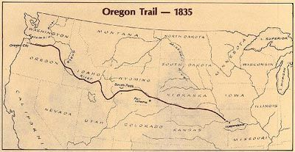
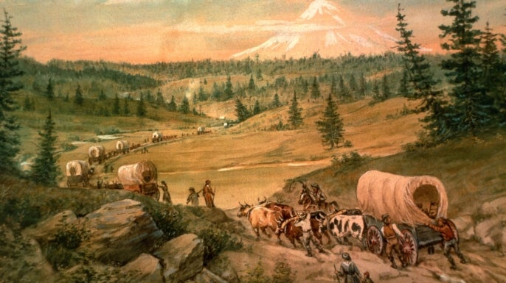
Oregon Trail 2,200 miles

Slide 15
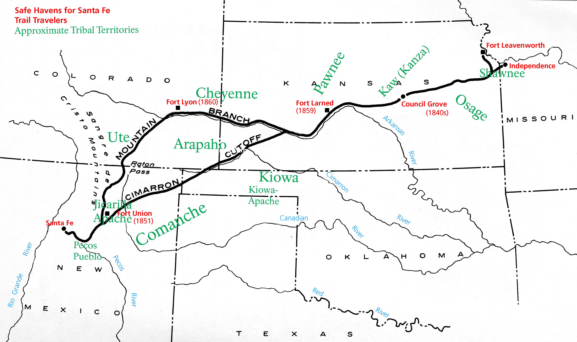
Santa Fe Trail – 800 miles

Slide 16
1844 – Samuel Morse sent the first telegraph message from Washington to Baltimore (40 miles)
Near instant news and financial reports
Great debate in the nation/congress about integrating with the Post
1851 Western Union Telegraph established
1847 – Postage stamps introduced in 5 and 10 cent denominations
Made mandatory on all mail in 1855
1861 – 1865 Impact of the Civil War
Great Stress on the postal system
Volume of mail by soldiers, prisoners
City delivery authorized in urban areas
Required named streets and numbered houses
Allowed for privacy –delivery of bad news
1863 Congress authorized a core of letter carries to deliver mail
More business, ALSO - A LOT OF JUNK MAIL AND SCAMS!
Preference to vets
6 day week/52 weeks a year, 20 miles a day, up to $800/year pay
1880 Two weeks of vacation per year

Slide 17
1847 Introduction of Postage Stamps
Revolutionary Payment Process
The introduction of postage stamps simplified the payment process for sending mail, making it more efficient.
Accessibility of Mail
Postage stamps made sending mail more accessible to the general public, encouraging communication.
Notes:
The introduction of postage stamps in the 1840s revolutionized mail delivery by simplifying the payment process. This innovation made sending mail more accessible to the public.

Slide 18
1864 - Congress authorized Money Orders
1864 – First trial Railway Mail System (RMS) between Chicago and Clinton Iowa
1890’s until the 1960’s the RMS carried the majority of letters and packages mailed in the United States
Sorting enroute
Workers put in 1 week shifts, 13 hour days
Dangerous due to;
Fire
Derailment
Robbery
New lower 2nd class rates introduced
Working conditions, discrimination and the spoils system spurred the creation of the first postal union

Slide 19
Railroad Station in the 1860’s

Slide 20
Sorting Mail in a Railway Post office Car

Slide 21
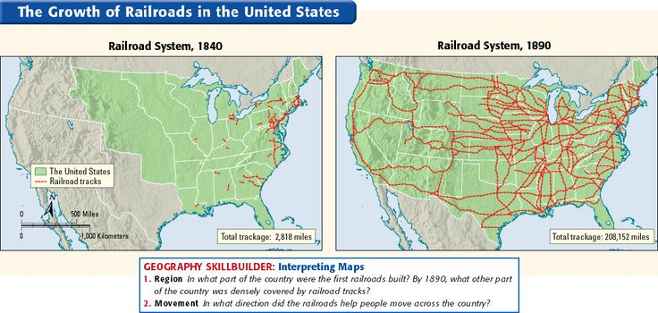

Slide 22
1896 Establishment of Rural Free Delivery
Introduction of RFD Service
The Rural Free Delivery service was introduced in 1896 to provide mail service to remote areas, enhancing communication.
Connecting Remote Communities
RFD was a crucial step in connecting rural communities, ensuring that individuals in remote locations could receive mail.
Impact on American Society
The establishment of RFD revolutionized communication and access to information for all Americans, regardless of location.
Notes:
In 1896, the Rural Free Delivery (RFD) service was established, ensuring that even those in remote areas could receive mail. This was a significant step in connecting all Americans, regardless of location.

Slide 23
1901 – 76,945 Post Offices
The number of carriers in 1899 = 500
By 1905 the number had grown to 32,000 earning $200/yr
This growth spurred many improved roads and bridges
During this growth new types of mail flourished
Magazines, greeting cards, post cards
Montgomery Ward catalog
Over 500 pages, 20,000 items
Sears Roebuck catalog – the consumers bible
1910 – congress authorized the Postal Saving System
$1 to 500 at 2% interest later raised to $2,500
Deposited in local banks at 2.5% interest
In 1913 Congress authorized Parcel Post delivery up to 11 pounds
300 million packages delivered in the first 6 months
Sears business quadrupled in 12 months

Slide 24
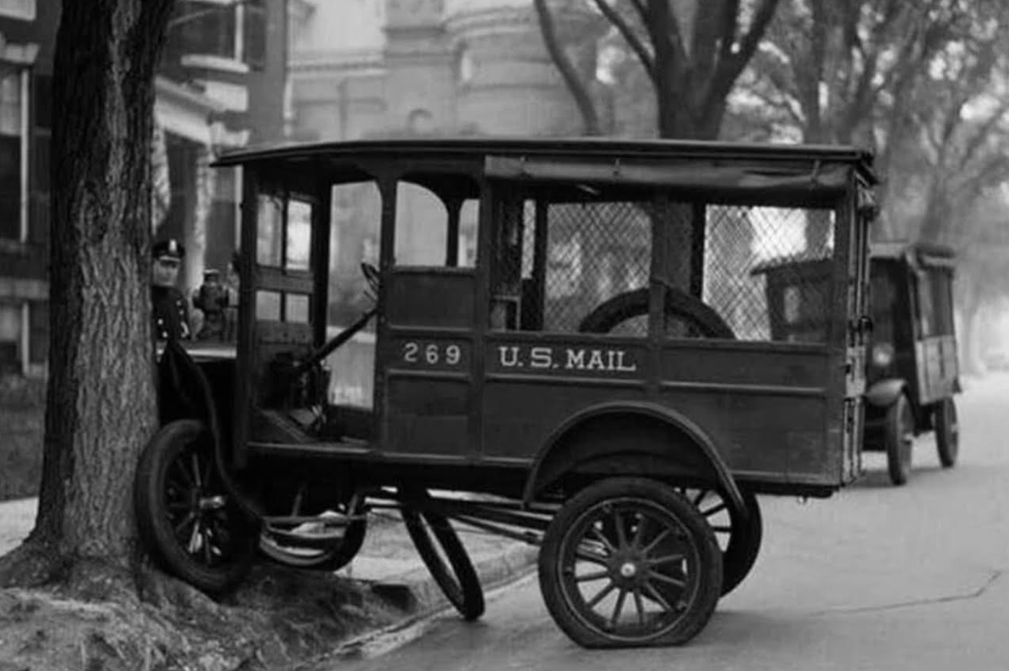
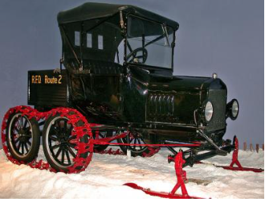
1908 the Ford Model T was selected to replace the horse in urban areas

Slide 25
1918 – Airmail
The first service was accomplished by the Postal Service and the Army between NY city and Washington
Later the Post Office took over the role
Early days were harrowing
No Radios, faulty compasses, open air cockpits
Pilots flew by dead reckoning
No towers or lights on the fields
Pilots used a half empty whiskey bottle to judge whether they were flying level
1925 – Congress passed “Contract Airmail Act”
Popularized by the likes of Charles Lindberg and Amelia Earhart
Early contractors were Boeing, Pan Am, United, Eastern, TWA, American
Improved infrastructure with airfields, lighted runways, communications

Slide 26
1929 – The stock market crashed, and the great depression ran up to WW 2
Great Stress place on the US Post Office
1941 WW 2
The post office had just got back to high volumes of mail and employment
Now it’s placed in CRISIS mode again
New methods needed to transport mail between the US and Europe
Victory Mail
Eastman Kodak microfiche
Women and minorities replacing those away during the war
African American women formed the 6888th Central Postal Directory Battalion stationed in Europe

Slide 27
1945 – 1970 Despite the advancement of modern communications – Radio, TV, Telephone mail volume grew
1945 -38 Billion pieces 1970 -70 Billion pieces
Cheaper to send a letter than talk on the telephone
After WW II reliance on rail travel was waning
1920 – 80% of intercity passenger train travel
1949 – Down to 8%
1957 – Down to 4%
By 1969 Americas operational railways had dwindled down from 208,517 miles of track to just 54,000 miles of track
Rail long distance passenger transportation was collapsing
Rail transportation becoming freight oriented.
Lost revenue caused bankruptcies and consolidation
This meant a major embrace of mail transportation via highways

Slide 28
Embracing the nation's highways for the transport of mail brought new challenge
Back to the Hub and Spoke method of sorting mail
Build new mail processing centers
Major challenge was existing postal infrastructure
Central offices in urban centers had no loading docks for trucks
Years of national crisis along with
Bare bones appropriations
Years of deficit spending
Congress was more interested in funding post war defense contracts
This led to the Post hiring more people than investing in automation costs

Slide 29
1961 – the US Post Office was the worlds largest buyer of transportation services
No CPA
No operating statements
Transportation costs had not been examined in 25 years
Primarily a seat of the pants operation
The average post office was 50 years old
1960’s Post Master Author Summerfield an Eisenhower appointee
Took on automation
Contracted with Pitney Bowes
Burroughs
Modernized the Detroit's mail post office into a showcase for the future

Slide 30
1959 – 1960 Brief experiment with Speed Mail based on FAX service
Documents transmitted from office to Office, printed and delivered
Halted by complaints from lobby (air, rail and Western Union)
1961 – Introduction of the ZIP Code (Zone Improvement Plan)
Digits 1, 2 and 3 identify an areas central mail facility
Digits 4 and 5 identify either a certain post office or in larger cities a postal zone
Facilitated “Work Sharing” >>>> EXPLAIN<<<<<
Additional digits added in 1978
By 1965 Optical Character Readers were being put into place
1966 During the chaos of the civil rights movement and the Vietnam War the Old Main Chicago Post Office Operations melted down
10 million pieces of mail choked operations, stacked up everywhere in halls, basements, into the streets…
Mostly 3rd class mail
Shutdown for 3 weeks

Slide 31
1960’s – 1970’s During Vietnam War and Civil Rights unrest
Over 700,000 Postal employees handling 79 Billion pieces of mail
Operating at a $1.3 billion deficit
1968 The president appointed a commission that issue a 212 page report titled “Towards Postal Excellence”
Emphasized that todays Post Office had become a business
Should be treated as a government owned corporation
Should be market driven
Should be supported by revenue from its customers, not taxpayers
Not actually privatized (yet) because only the federal government could handle the finances needed the sustain it
It should be run by a board of directors
Set postage rates
Employees receive the right to collective bargaining but not to strike
Operate on a balanced budget while maintaining universal service to every American everywhere for the same low price

Slide 32
1970 – Very Volatile year for the Post Office
Nation wide strike in March shut down much of the nations mail
Average letter carrier earned barley $6,000 per year which was below the national median income of $7,500
After 21 years the top salary peaked at $8,000
The impact affected business, stock market, every citizen, draft notices, ….
1970 - Nixon signed Postal Reorganization Act
Downgraded from a cabinet position
Run by a board of governors nominated by the president and confirmed by the Senate( today with the Senates advice and consent)
The board appoints the Postmaster General
Renamed into the United States Postal Service (USPS)
Designated an “independent establishment of the executive branch”
Eliminated the Spoils system
Postal revenues were appropriated to a new Postal Service Fund
The USPS could use as needed without asking Congress
Authorized the USPS to borrow money to bring its buildings and equipment into the 20th century

Slide 33
For the rest of the 20th century performance improved
The USPS supported itself at stable prices between the 1980’s and 2007 without any tax dollars
Supporting a huge middle class workforce
Computerization now handled 40 million address changes per year that were previously done manually
The Big Glitch however was that management was stuck on moving mail and balancing books not on embracing new technologies which was also influenced by special interest lobbies to shut efforts down
Email
Internet
Photocopiers
Ecommerce

Slide 34
2001 – 2009 G W Bush and the 2006 Postal Act
GAO Report “Embracing the Future: Making the Tough Choices to Preserve Universal Mail service”
Conclusion:
The post’s efforts innovate had been “largely disappointing”
Recommended that the USPS be required to focus on its core Mission
Delivery of letters, newspapers, magazines, advertising mail, and parcels
Some exceptions like expediting passports were allowed
Required the USPS to prefund (for 75 years) retiree health care benefits earned by its employees
Starting in 2007 the USPS was ordered to pay the US treasury $5.5 billion annually for 10 years
The service began reporting huge annual deficits that same year
Since 2011 the USPS has defaulted in these payments
Efforts to reduce them to a more manageable level have been complicated by various legislators

Slide 35
Modern Vehicles and Airplanes
Modern vehicles and airplanes have further transformed mail delivery methods, enabling swift and efficient distribution nationwide.

Slide 36
Inovations
Horseback Riders
In the early days, horseback riders were essential for delivering mail across long distances and rough terrains.

Slide 37
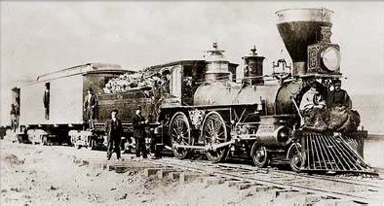
Steamships and Railroads
The introduction of steamships and railroads revolutionized mail delivery, allowing for faster and more reliable service.

Slide 38
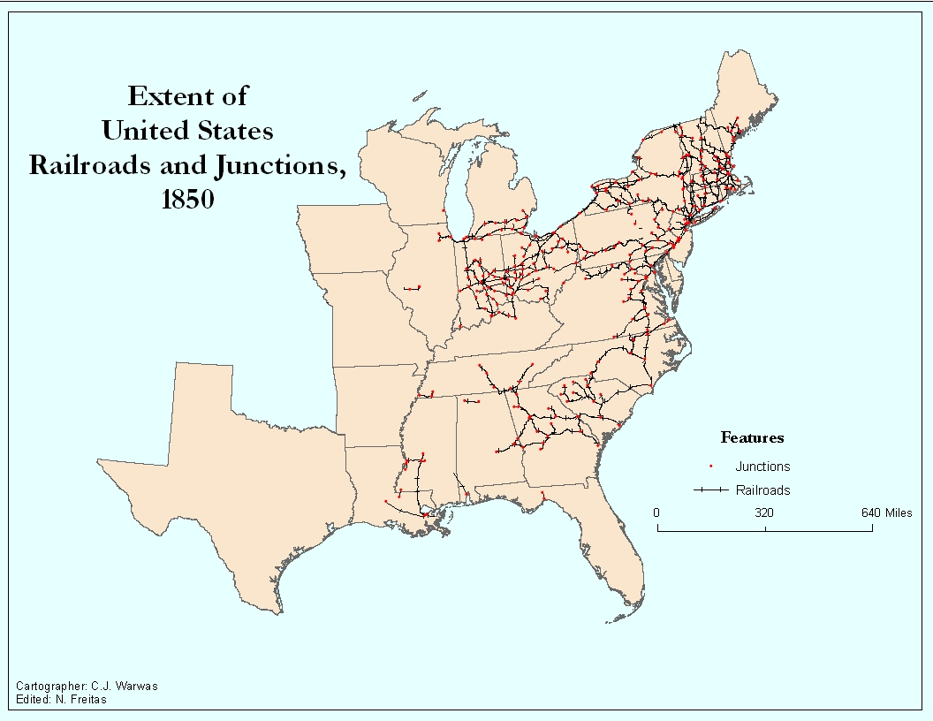

Slide 40
Challenges and Reforms
Notes:
Throughout its history, the US Postal Service has faced numerous challenges, prompting reforms to ensure its continued viability and relevance in a changing world.

Slide 41
Financial Challenges and Funding
Declining Mail Volumes
The Postal Service is experiencing a continuous decline in mail volumes, impacting its revenue and financial health.
Rising Operational Costs
Rising operational costs are putting additional pressure on the Postal Service's finances, complicating its sustainability efforts.
Funding Discussions
Ongoing discussions about funding and financial sustainability are crucial for the future of the Postal Service.
Notes:
The Postal Service has faced ongoing financial challenges due to declining mail volumes and rising operational costs. Discussions about funding and financial sustainability remain critical.

Slide 42
Technological Advancements
Rise of Digital Communication
The increase in digital communication has significantly impacted the operations of the Postal Service, leading to necessary adaptations.
Automated Sorting Systems
Implementing automated sorting systems has improved the efficiency and speed of mail processing within the Postal Service.
Online Services Implementation
The adoption of online services has allowed the Postal Service to cater to customer needs in a digital world.
Notes:
With the rise of digital communication, the Postal Service has had to adapt to new technologies. Implementing automated sorting systems and online services has become essential for efficiency.

Slide 43
Modernization and Automation
Streamlining Operations
The Postal Service aims to streamline its operations through modernization efforts, improving efficiency and reducing operational costs.
Enhancing Customer Service
Innovative solutions are being implemented to enhance customer service, ensuring quicker and more reliable delivery options.
Adopting New Technologies
The Postal Service is adopting new technologies to remain competitive in a rapidly changing market, focusing on automation.
Notes:
To remain competitive, the Postal Service is focusing on modernization and automation efforts, aiming to streamline operations and enhance customer service through innovative solutions.

Slide 44
Impact on Society and Economy
Notes:
The US Postal Service has significantly influenced American society and the economy, serving as a vital link for communication, business, and government operations.

Slide 45
Connecting Communities
Role of the Postal Service
The Postal Service has been vital in connecting communities, facilitating communication and the exchange of information.
Community Communication
By ensuring reliable mail delivery, the Postal Service fosters connections among community members, regardless of their locations.
Sharing Information
The service enables individuals to share important news, updates, and personal messages, strengthening community ties.
Notes:
The Postal Service has played a crucial role in connecting communities across the nation, ensuring that people can communicate and share information regardless of distance.

Slide 46
Facilitating Commerce
Reliable Mail Delivery
The Postal Service ensures reliable mail delivery, which is crucial for the success of businesses across the country.
Enabling Business Operations
With efficient mail services, businesses can operate effectively and maintain regular communication with customers.
Customer Reach
The Postal Service allows businesses to reach customers nationwide, expanding their market reach and customer base.
Notes:
By providing reliable mail delivery, the Postal Service has facilitated commerce, enabling businesses to operate effectively and reach customers throughout the country.

Slide 47
Supporting Government and Military Operations
Essential Government Operations
The Postal Service plays a vital role in ensuring that official communications for government operations are delivered efficiently and reliably.
Support for Military Personnel
The Postal Service provides crucial mailing services that keep military personnel connected with loved ones and receive important information while deployed worldwide.
Notes:
The Postal Service is essential for government operations, ensuring that official communications are delivered. Additionally, it supports military personnel by providing mail services worldwide.

Slide 48
The Future of the US Postal Service
Given our current political environment this may be a reach
Notes:
As the landscape of communication changes, the future of the US Postal Service depends on its ability to adapt and innovate in response to emerging challenges.

Slide 49
Adapting to Digital Communication
Embracing Technology
The Postal Service needs to adopt new technologies to improve its efficiency and service delivery in the digital era.
Enhancing Online Services
Improving online services will help the Postal Service meet customer expectations and increase satisfaction in digital communication.
Integrating Digital Communication
Finding ways to incorporate digital communication will streamline operations and improve overall workflow in the Postal Service.
Notes:
To thrive in the digital age, the Postal Service must adapt by embracing technology, enhancing its online services, and finding ways to integrate digital communication into its operations.

Slide 50
Addressing Sustainability Concerns
Importance of Sustainability
Sustainability is crucial for the future, impacting every sector, including postal services, necessitating a shift in practices.
Environmental Concerns
Environmental concerns are growing, and addressing them is vital for the Postal Service to remain relevant and responsible.
Reducing Carbon Footprint
The Postal Service must focus on reducing its carbon footprint through efficient logistics and green technologies.
Notes:
Sustainability is becoming increasingly important, and the Postal Service will need to address environmental concerns, focusing on green practices and reducing its carbon footprint.

Slide 51
Potential Reforms and Innovations
Improving Efficiency
Reforms aimed at improving operational efficiency can lead to faster delivery times and reduced costs for the Postal Service.
Enhancing Customer Service
Innovations that enhance customer service can create a more user-friendly experience and increase customer satisfaction.
Adapting to Change
Reforms should address changing societal needs, ensuring the Postal Service remains relevant in a digital age.
Notes:
Looking forward, the Postal Service may consider reforms and innovations to improve efficiency, enhance customer service, and ensure that it meets the needs of a changing society.

Slide 52
Conclusion and Thoughts
Rich History
The US Postal Service has a long and storied history that highlights its evolution over the years, responding to the needs of society.
Impact on Society
The Postal Service plays a crucial role in connecting people, facilitating communication, and supporting the economy through reliable mail delivery.
Future Challenges
Addressing future challenges such as digital communication and funding will be vital for the continued success of the Postal Service.
Notes:
The US Postal Service has a rich history marked by evolution and adaptation. Its impact on society and the economy is profound, and addressing future challenges will be critical to its continued success.

Slide 53
First class mail is down 25%
Everyone agrees something must be done
Legislature is in no hurry to fix it
Today there’s approximately 36,000 post offices
3,000 make up 46% of the revenue
USPS shut down half of its major distribution centers
Jobs being reduced by attrition
Reducing hours at smaller postal locations
Proposals to slow down 1st class mail and eliminate Saturday delivery
Potential impact of Project 2025 proposals

